Slide 1
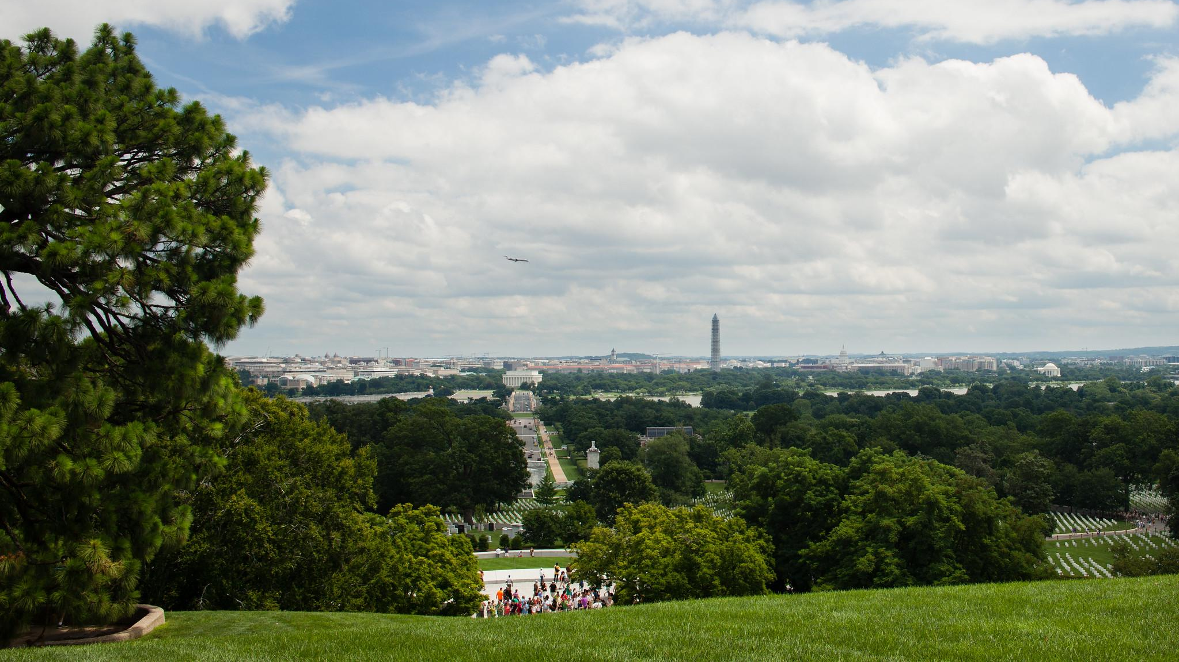
A Local Government Guide to the Chesapeake Bay
Module 4: Capitalizing on the Benefits of Trees
Notes:
Photo by O. Giron/Chesapeake Bay Program

Slide 2
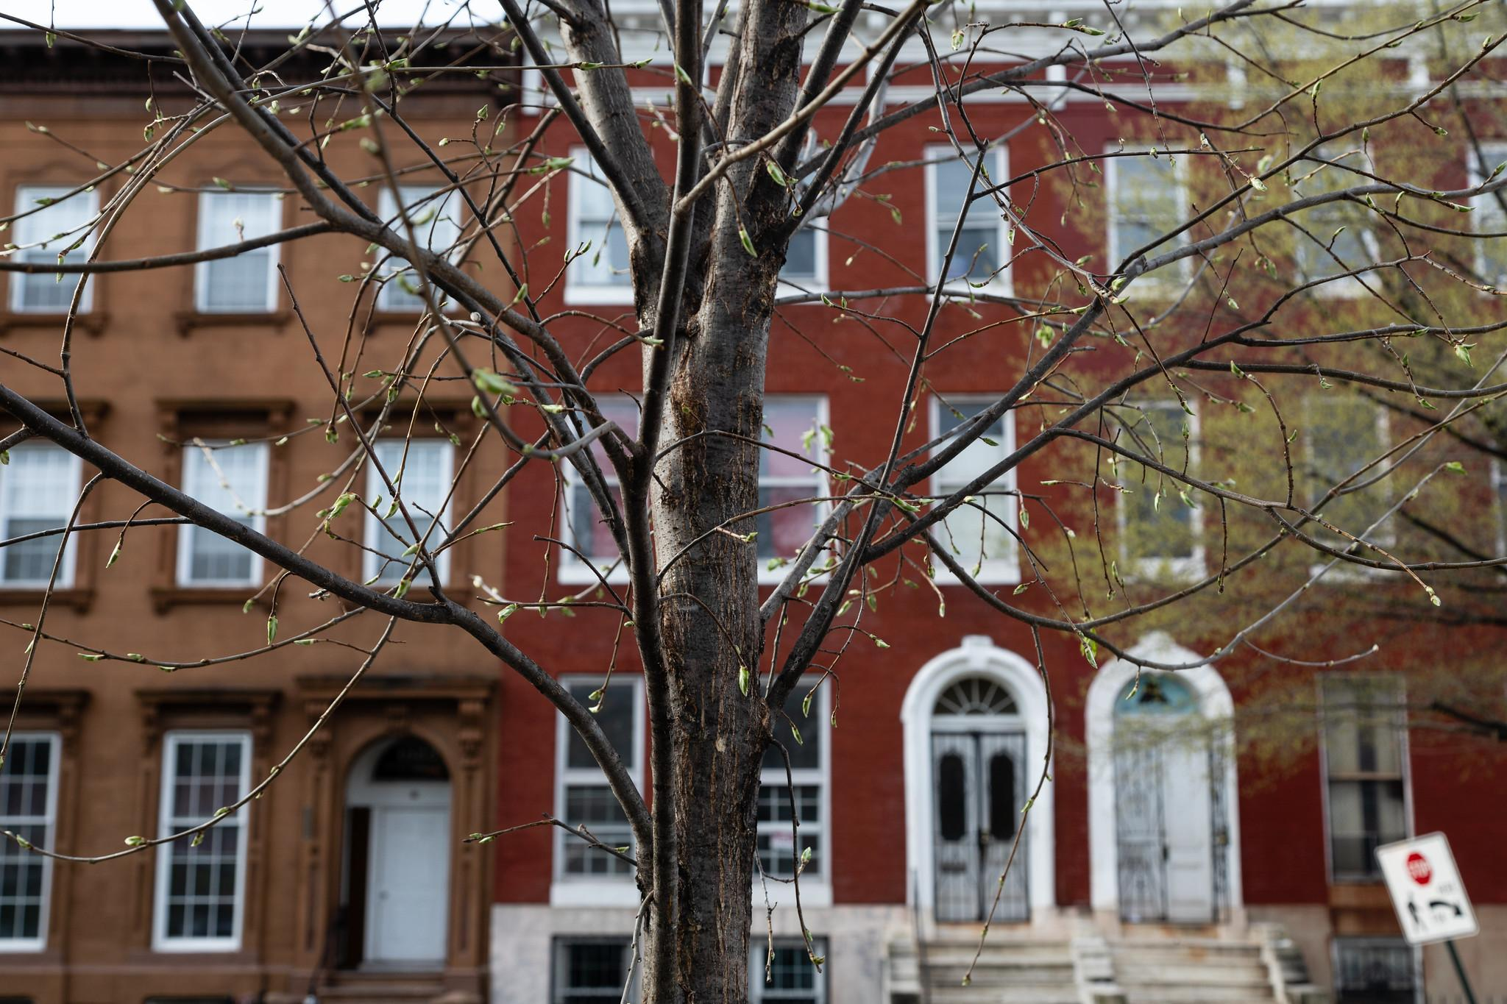
Table of Contents
1
Purpose
What You’ll Learn
Benefits to Your Community
Enhancing Community Trees
What You Can Do
To Learn More
Glossary
2
3
4
5
6
7
*Please refer to individual slide notes for data references and sources.
Module 4: Capitalizing on the Benefits of Trees
Notes:
Photo by W. Parson/Chesapeake Bay Program

Slide 3




A Guide For Local Governments
To help local government representatives better understand how the information in the modules aligns with their priorities, look for these icons:
As a local leader, your decisions set the course for your community. Your actions determine the health and vitality of your jurisdiction, as well as that of your local waterways and the Chesapeake Bay. You can achieve win-win outcomes by prioritizing local economic development, infrastructure resiliency, public health, and education while also protecting your environment.
This module is one in a series created by the Chesapeake Bay Program to support and inform decision making by local officials. We encourage you to examine the full suite of modules listed on the next slide.
Economic Development
Public Health & Safety
Infrastructure Maintenance & Finance
Education
Capitalizing on the Benefits of Trees
Purpose

Slide 4
A Guide For Local Governments
Available Local Government Modules
How Your Watershed Works
Foundations of Clean Water
Clean Water for the Economy
Capitalizing on the Benefits of Trees
Preserving Local Character and Landscapes
Protecting Your Infrastructure Through Stormwater Resiliency
Building the Workforce of Today and Tomorrow
Preparing Your Community for Water Extremes
Understanding and Supporting Your Agricultural Allies
Keys to Engaging Your Community on Sustainability
Your Health and the Environment
Access the full set of modules here: bitly link
Capitalizing on the Benefits of Trees
Purpose

Slide 5
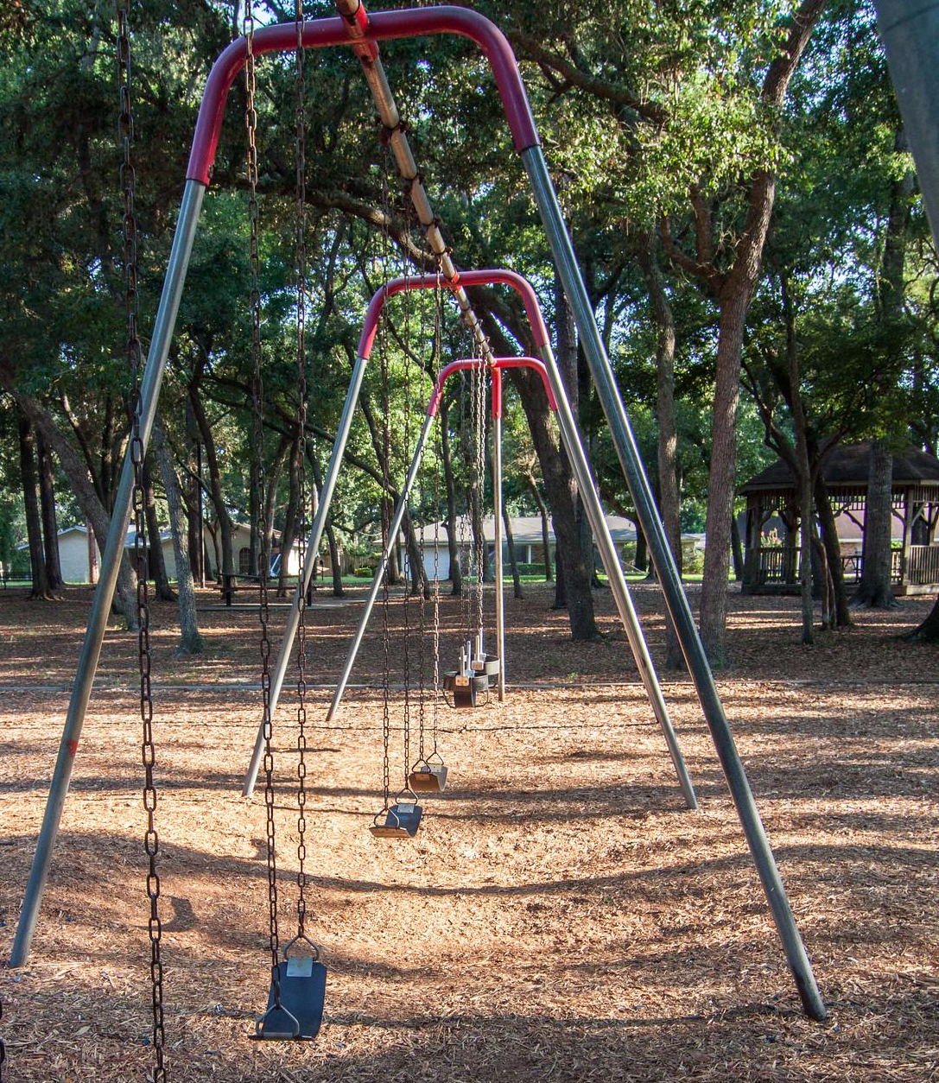
Laying Foundations
Trees benefit your local community. Trees are natural, low-cost solutions to many municipal problems when compared to manmade systems. In this module, you’ll learn about the benefits of trees and how they can be used to maximize those benefits.
Capitalizing on the Benefits of Trees
Purpose
Notes:
Photo by Leslie Robertson for the National Association of State Foresters

Slide 6
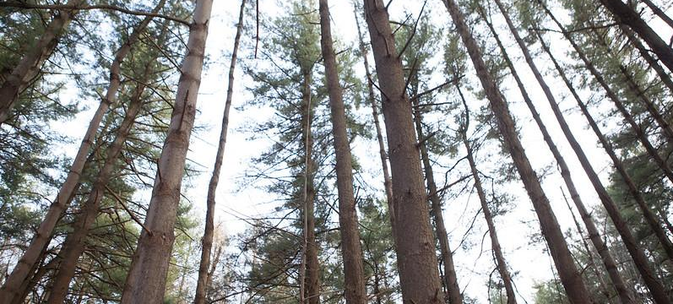
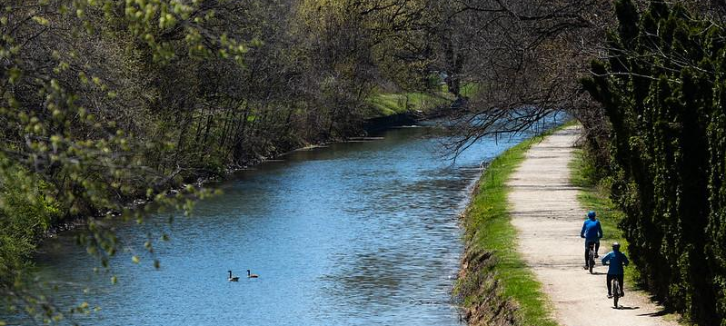
What You’ll Learn
What can I do to enhance trees in
my community?
What are the benefits of trees in my community?
Capitalizing on the Benefits of Trees
What You’ll Learn
Notes:
Photos by W. Parson and S. Droter (Chesapeake Bay Program)

Slide 7
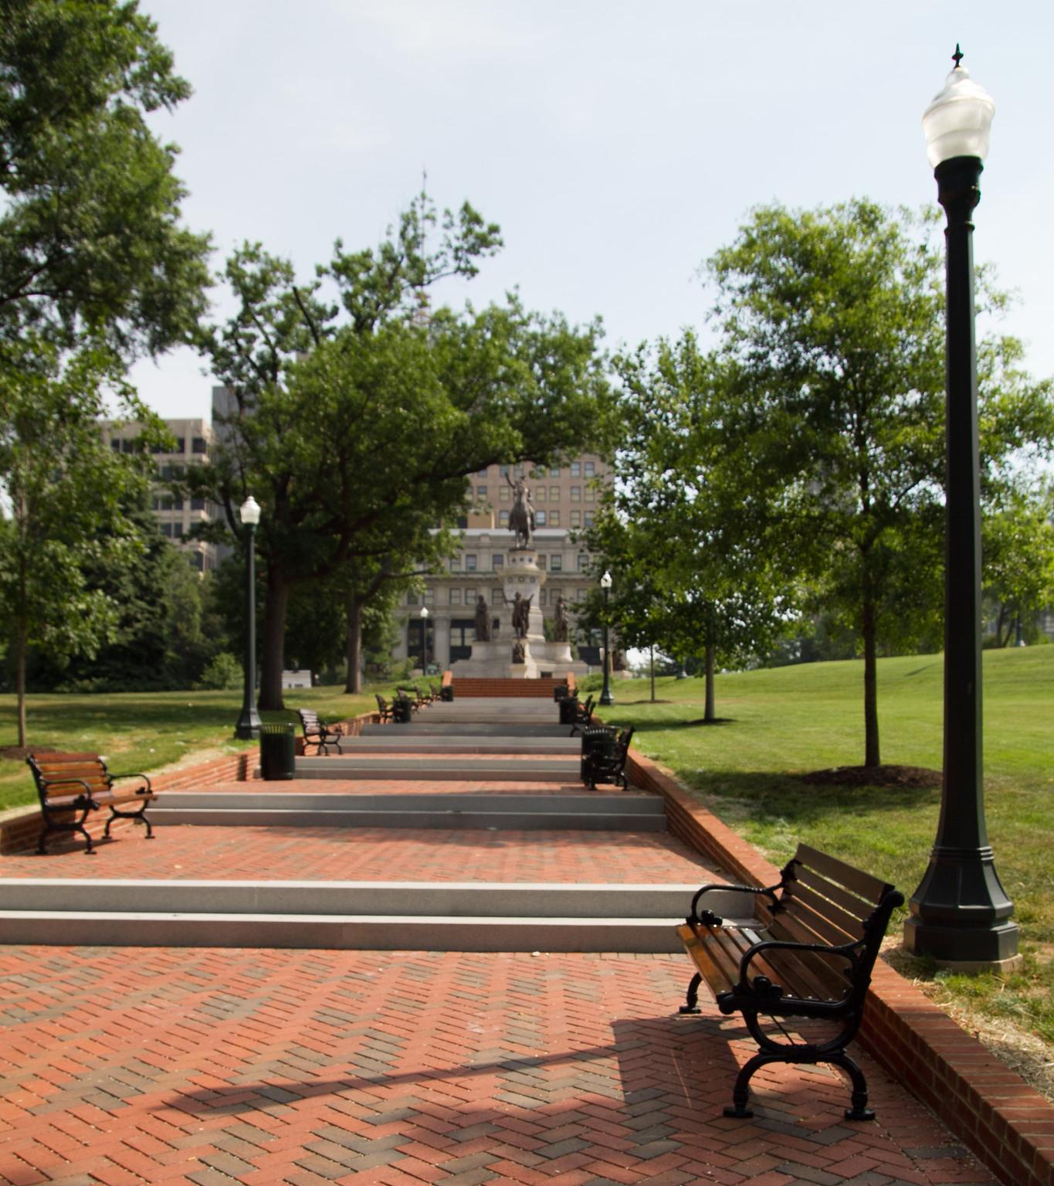
Benefits to Your Community
Community trees improve the local economy, public health and safety, community infrastructure, and education.
Notes:
Photo by M. Rath/Chesapeake Bay Program

Slide 8
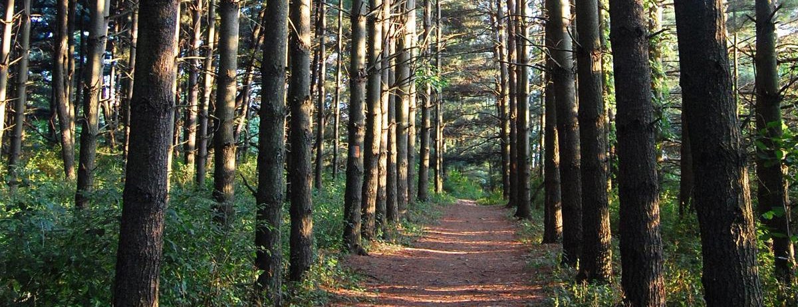
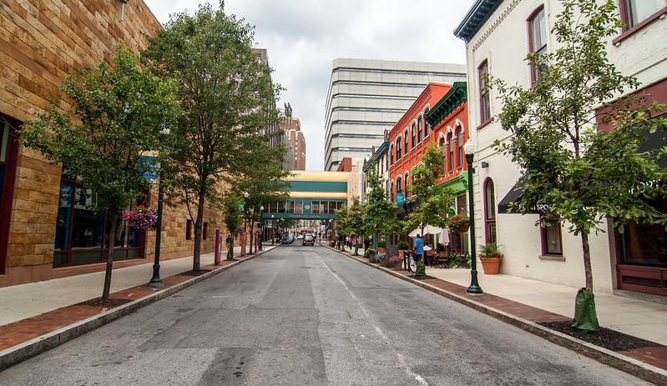

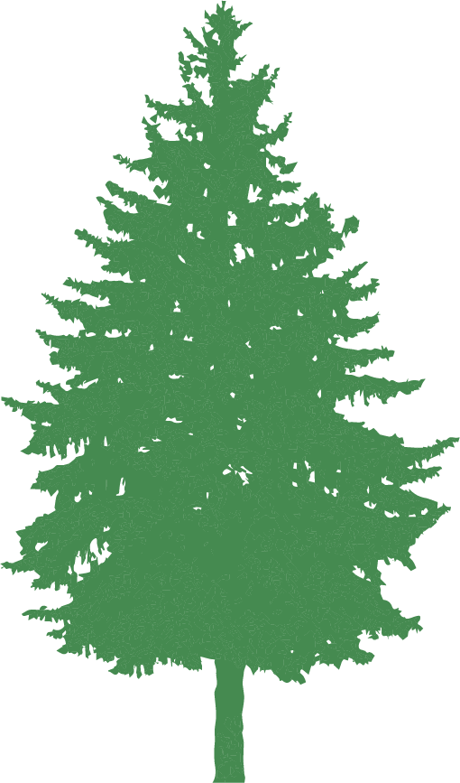
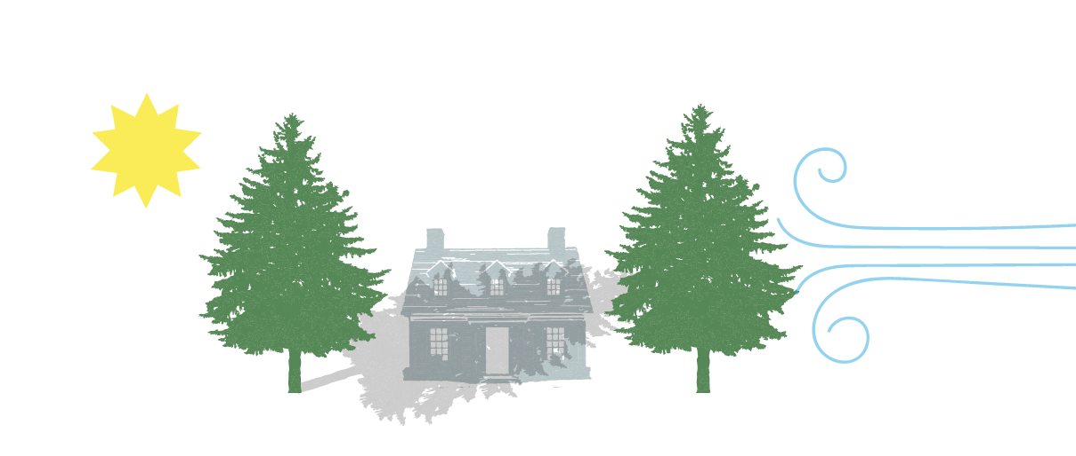
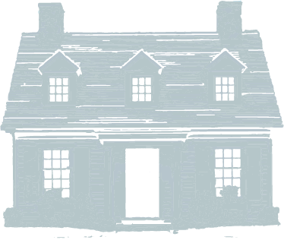
Economic Development
Annually, the trees in the watershed provide at least
$24 billion
in the form of carbon removal, flood control, wildlife habitat, and recreation.
A home near natural forests earns an average $10k property premium (more than near golf courses or specialty parks).
A neighborhood with good tree cover leads to 6-9% increases in home value because the homes are perceived as more scenic and private.
C
O
O
Customers spend more time & 11% more money in well-treed areas.
Case study: Pembroke Woods
Developers in Frederick County, MD saved over $360k by leaving trees and wetlands undisturbed in a residential subdivision. The savings were primarily stormwater benefits and reduced clearing costs.
Well-placed trees can save 21-24% in cooling costs and up to 25% in heating costs.
Capitalizing on the Benefits of Trees
Benefits to Your Community
Notes:
References:
Column 1:
Wolf, K.L. August 2007. City Trees and Property Values. Arborist News 16, 4: 34-36. https://www.naturewithin.info/Policy/Hedonics.pdf
https://www.chesapeakebay.net/issues/forests
Column 2:
Clar, M. (2005). Pembroke Woods: Lessons learned in the design and construction of an LID subdivision. In Managing Watersheds for Human and Natural Impacts: Engineering, Ecological, and Economic Challenges (pp. 1-9).
Wolf, K. L. (2005). Business district streetscapes, trees, and consumer response. Journal of Forestry, 103(8), 396-400.
Shoup, L., & Ewing, R. (2010). The economic benefits of open space, recreation facilities and walkable community design. A Research Synthesis. Princeton, NJ, Active Living Research, a National Program of the Robert Wood Johnson Foundation.
Column 3:
https://www.chesapeakebay.net/content/publications/cbp_19673.pdf
Simpson, J. R. (2002). Improved estimates of tree-shade effects on residential energy use. Energy and Buildings, 34(10), 1067-1076.
McPherson, E. G., & Rowntree, R. A. (1993). Energy conservation potential of urban tree planting. Journal od Arboriculture, 19(6), 321-331.
Photos by W. Parson/Chesapeake Bay Program and Leslie Robertson for the National Association of State Foresters

Slide 9
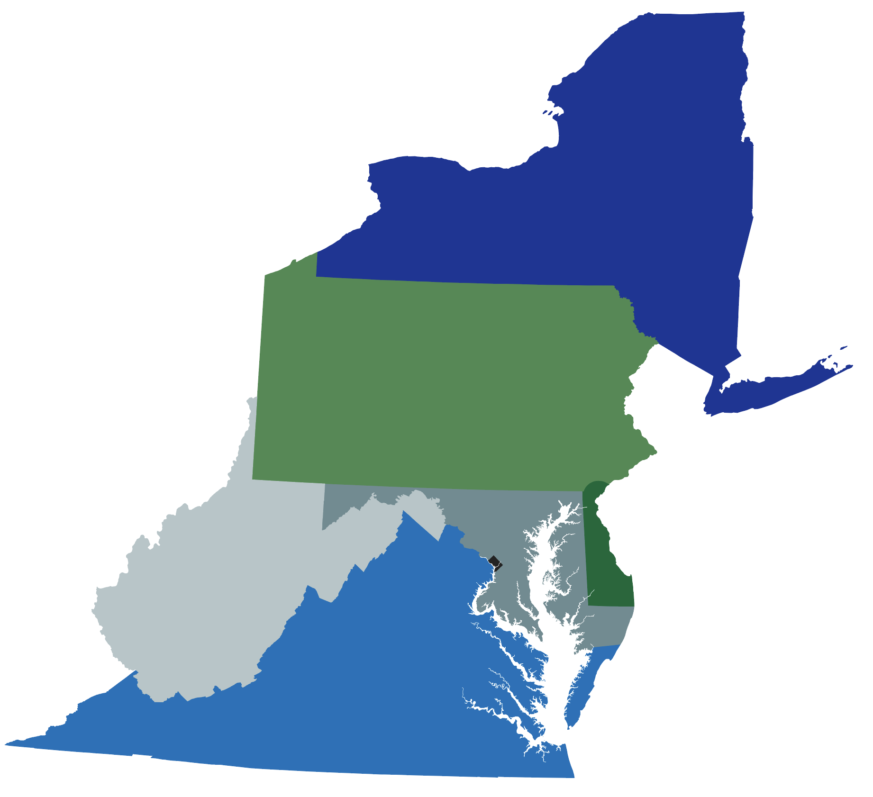




Recreation on Forested Land
Forests support robust local outdoor recreation economies.
Nationally, outdoor recreation contributes:
Within the watershed states:
NY:
$29.2 billion
291,429 jobs
1234 5678 8765 4321
$887 BILLION
7.6 MILLION
in consumer spending
American jobs
PA:
$13.2 billion
170,565 jobs
DE:
$1.3 billion
18,186 jobs
%
WV:
$1.5 billion
22,543 jobs
$65.3 BILLION
$59.2 BILLION
MD:
$7.1 billion
89,335 jobs
in federal tax revenue
in state & local taxes
VA:
$9.3 billion
123,369 jobs
DC:
$1.6 billion
17,218 jobs
Capitalizing on the Benefits of Trees
Benefits to Your Community
Notes:
References:
The Outdoor Recreation Economy (Outdoor Industry Association) https://outdoorindustry.org/resource/2017-outdoor-recreation-economy-report/
The Bureau of Economic Analysis https://www.bea.gov/data/special-topics/outdoor-recreation

Slide 10
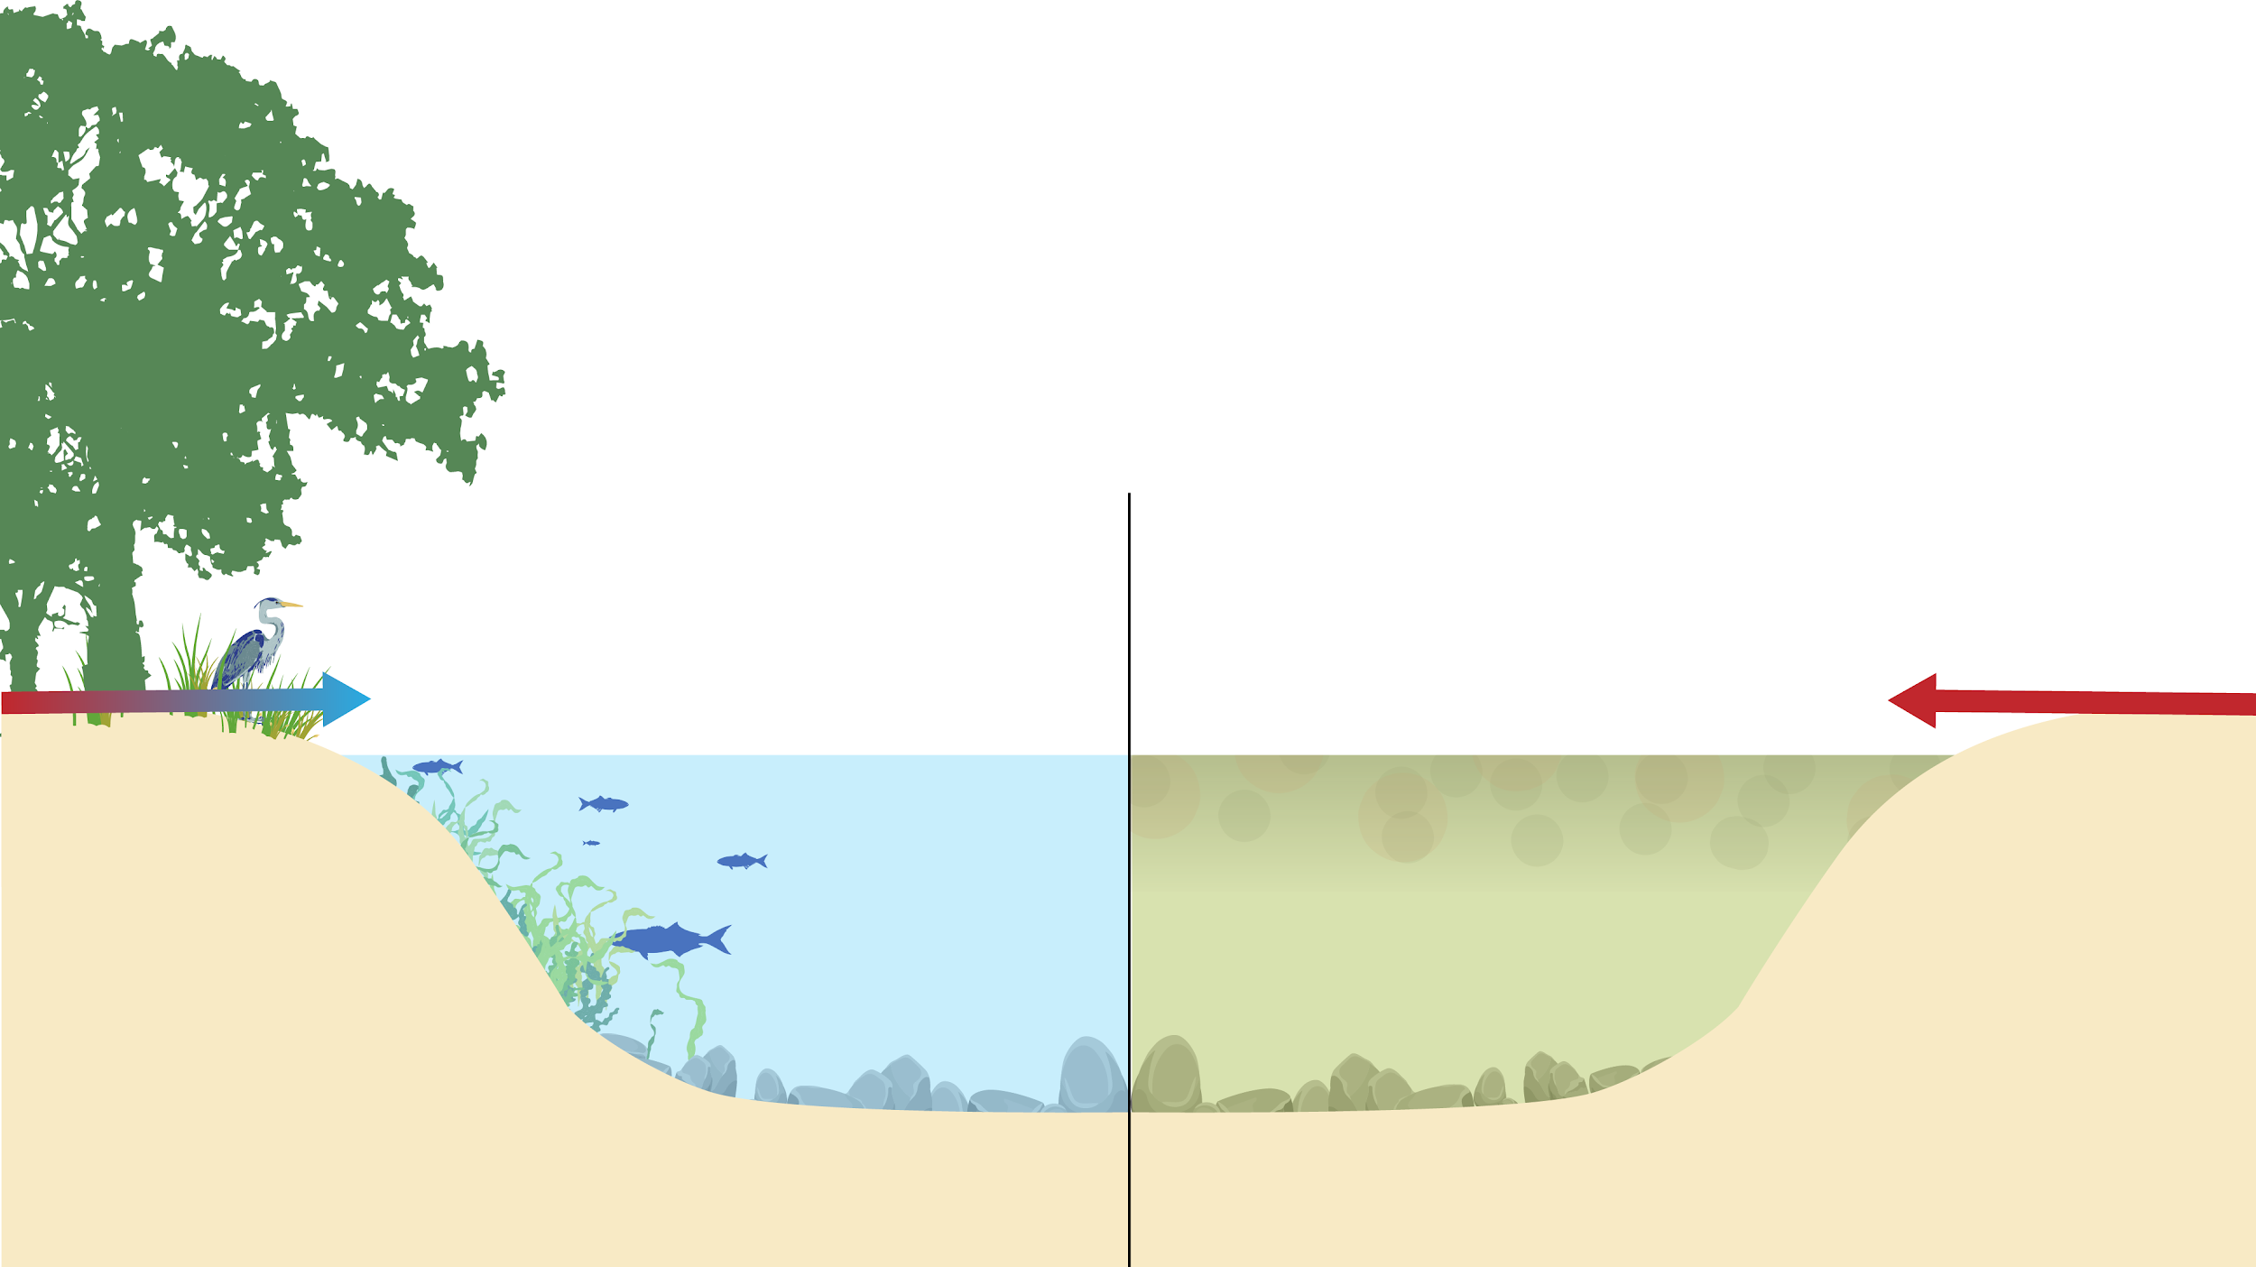


Clean Air and Water
Trees remove over 650,000 tons of air pollution in the US each year. They are a frontline defense to reduce air pollution-related deaths and respiratory disease.
Trees beside local waterways can also reduce polluted runoff by 30-98%, which includes:
Nutrients
Bacteria
Sediment
Agricultural biproducts
Urban toxic contaminants
Microplastics
Filtered runoff
Polluted runoff
N
P
P
N
N
Cl
Cl
P
Cl
Cl
Find the definitions and impacts on humans and wildlife of the glossary words on slide 30.
Capitalizing on the Benefits of Trees
Benefits to Your Community
Notes:
References:
https://www.chesapeakebay.net/channel_files/26661/tree_canopy_wip_temaplate_11.30.18_kw.pdf

Slide 11
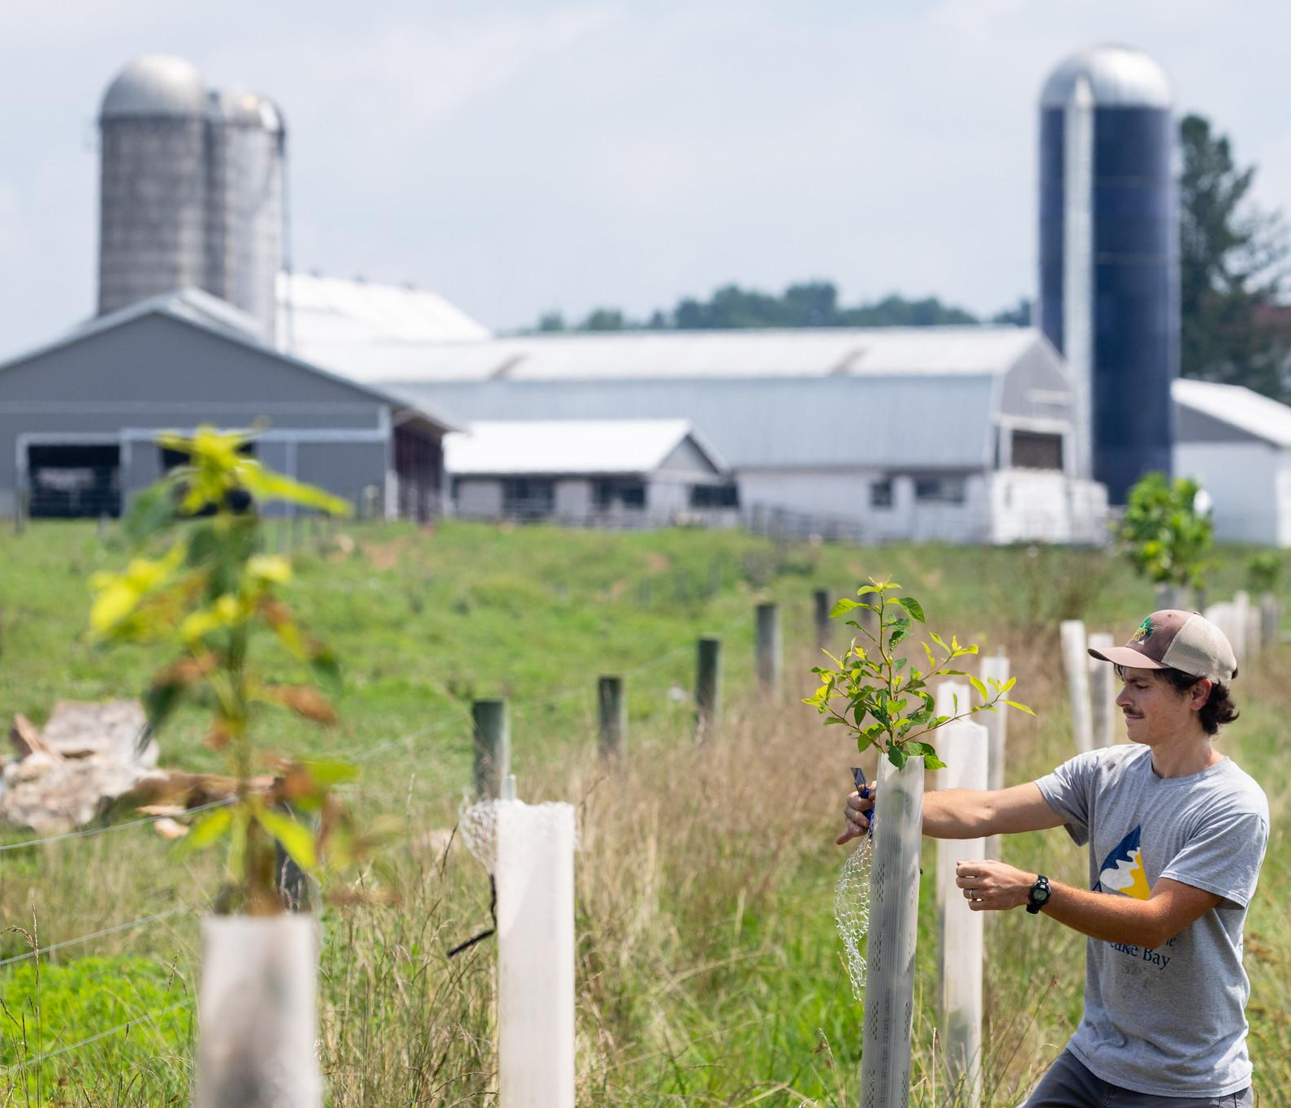
Benefits for Agriculture
Strategically planted or conserved trees on farms can reduce soil erosion and prevent pollutants, like fertilizers and pesticides, from reaching local waterways.
Trees can also act as a visual and noise barrier and provide safe corridors for wildlife movement.
Capitalizing on the Benefits of Trees
Benefits to Your Community
Notes:
References:
https://www.chesapeakebay.net/images/press_release_pdf/The_Role_and_Function_of_Forest_Buffers_For_Nonpoint_Source_Management_in_the_Chesapeake_Bay_Basin.pdf
Photos by W. Parson/Chesapeake Bay Program

Slide 12
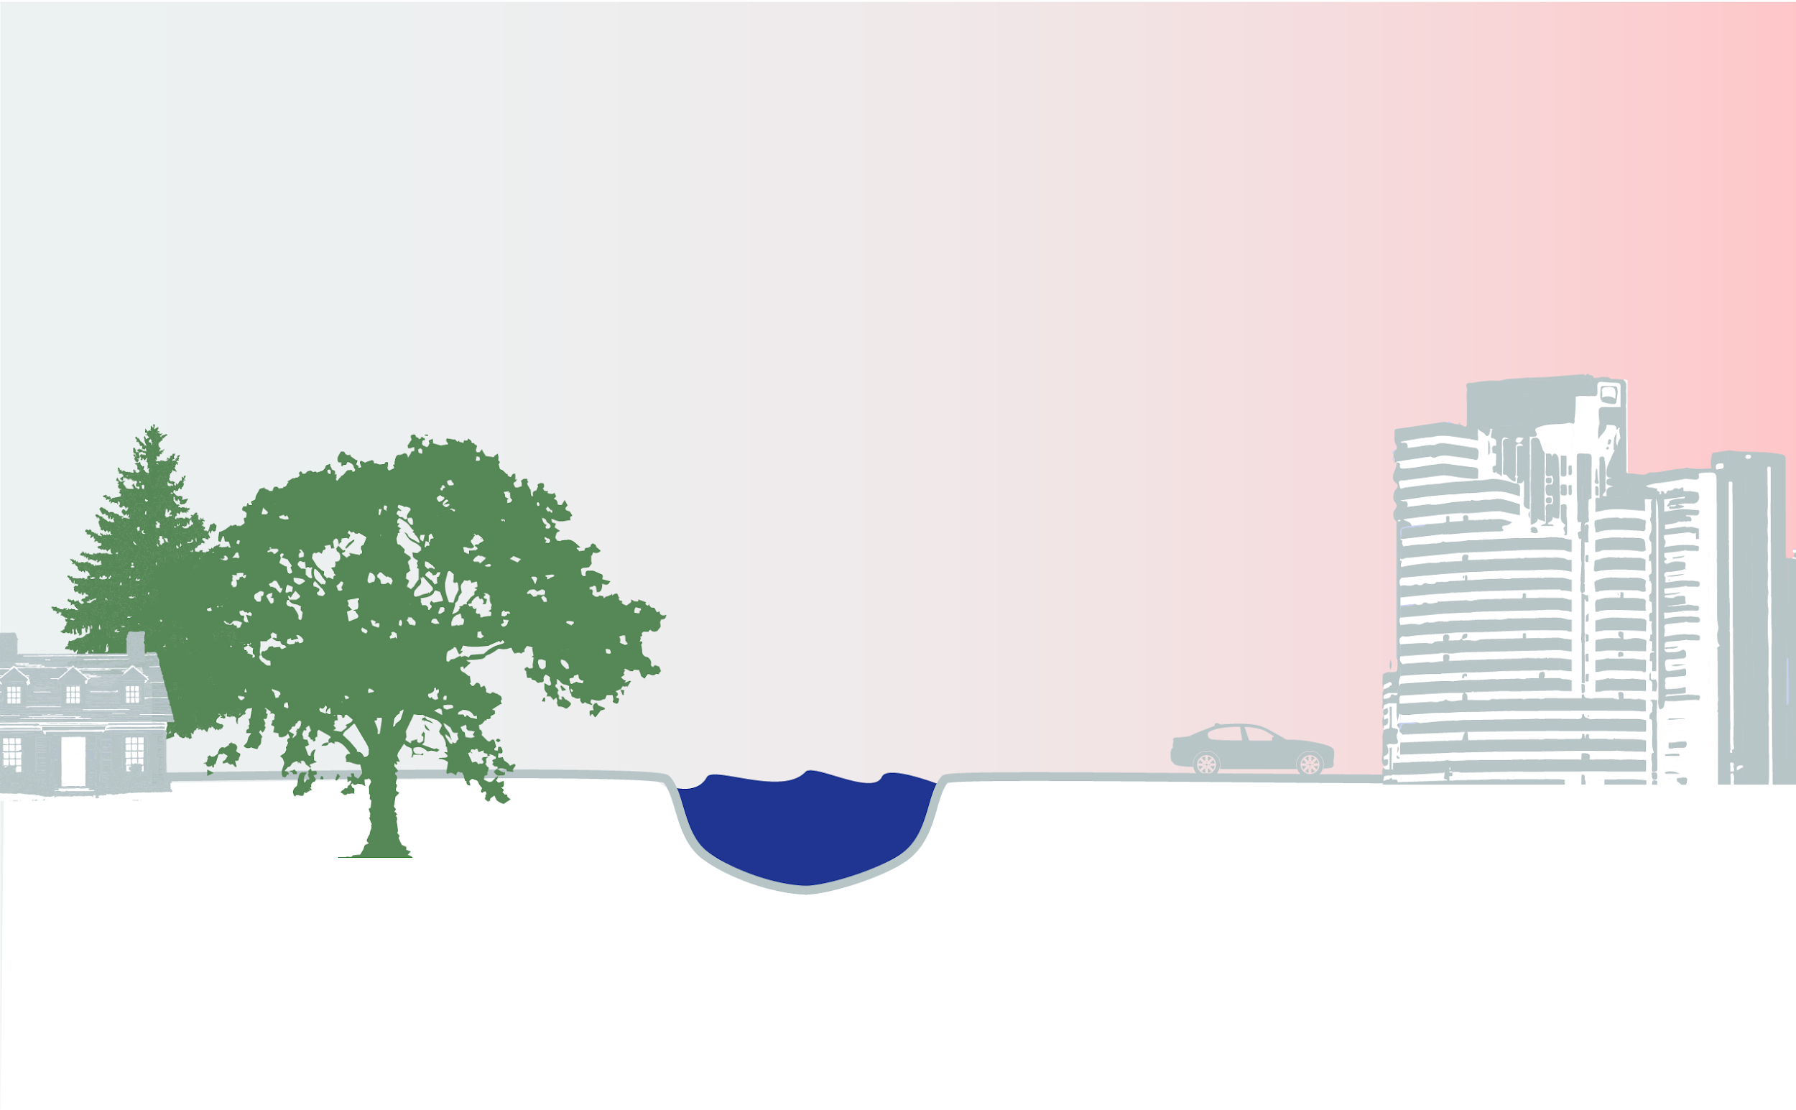
Urban Heat Islands
Urban heat islands experience extreme high temperatures due to the forces illustrated below. They can increase the magnitude & duration of heat waves in cities, elevating instances of heat stroke, heat exhaustion, and death. The elderly and those with pre-existing conditions are especially at risk.
Trees cool the air by creating shade and transpiring, or the process of their leaves releasing cooling water vapor into the air.
Buildings trap heat.
Dark surfaces like roads absorb and re-emit more of the sun’s heat.
Cars, and other machinery like air conditioners, produce heat.
Capitalizing on the Benefits of Trees
Benefits to Your Community
Check out and share this Urban Heat Island Poster for Vulnerable Populations.
Notes:
References:
https://www.epa.gov/heatislands

Slide 13
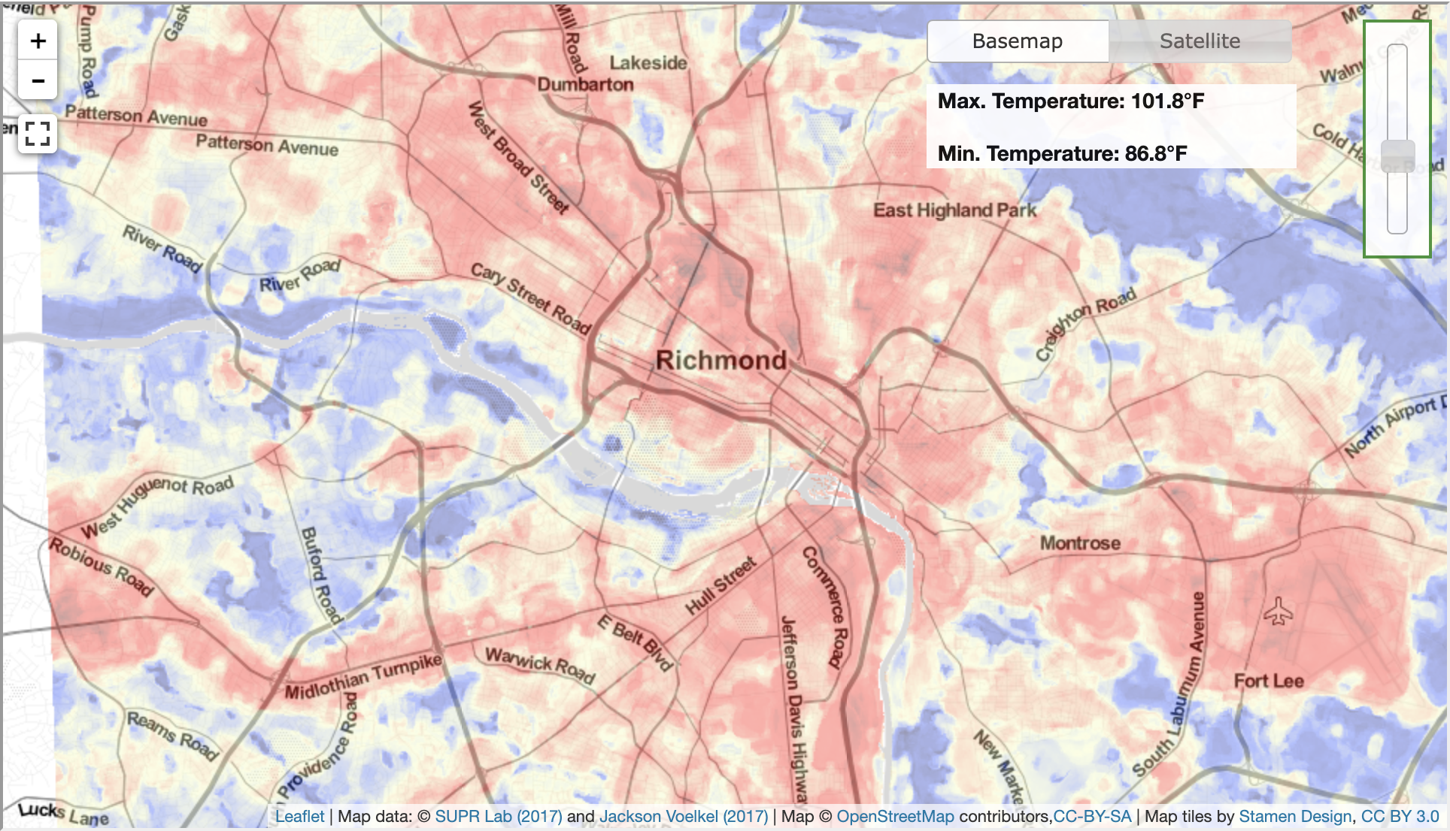
Urban Heat Islands
Case study: Urban Communities
A study from the Science Museum of Virginia found higher temperatures in historically redlined neighborhoods when compared to higher income, whiter neighborhoods in 94% of studied urban areas.
Redlining is the historical practice of refusing home loans or insurance to neighborhoods based on a racially motivated perception of investment safety. The historically redlined neighborhoods (predominantly lower income and communities of color) were up to 7° warmer, which was partly attributed to less tree cover. In your planning, consider and address such inequities so that everyone benefits from trees. Engage your community to make sure that your work addresses their needs and priorities.
Map and study by Jeremy Hoffman, Throwing Shade RVA
Climate Connection
Warmer temperatures exacerbate the public health risks in heat islands. Heat island temperatures will increase with the rise in average air temperature, causing more deadly consequences.
Capitalizing on the Benefits of Trees
Benefits to Your Community
Notes:
References:
Throwing Shade in RVA by Jeremy Hoffman: http://jeremyscotthoffman.com/throwing-shade
https://www.mdpi.com/2225-1154/8/1/12/htm

Slide 14
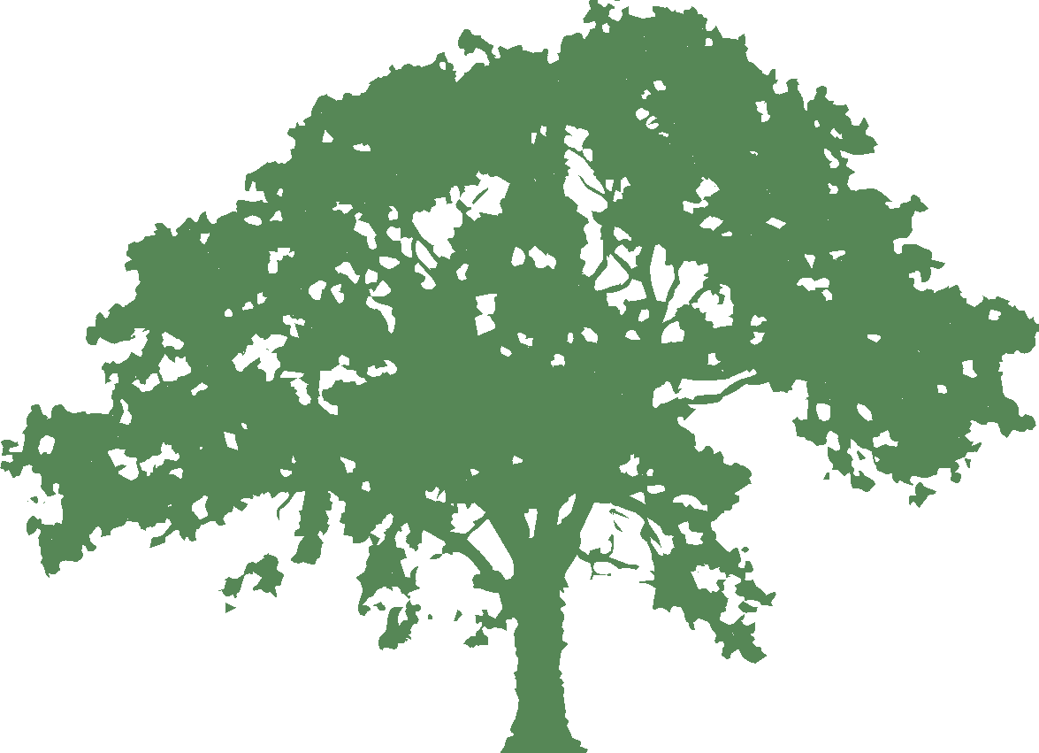

Public Health and Safety
Many studies show that being in nature and forests, from taking a walk to practices like “forest bathing” where one immerses one’s senses in the forest atmosphere, increases immunity and well-being.
Community trees also bring people together outdoors, leading to lower societal health care costs due to increased exercise and stress relief as well as higher neighborhood vigilance, which discourages criminal activity.
Trees are correlated with reductions in:
Mental fatigue
& aggression
Gun violence
Domestic
violence
Explore more about how trees benefit your community’s health at Healthy Trees, Healthy Lives.
Capitalizing on the Benefits of Trees
Benefits to Your Community
Notes:
References:
The Economic Benefits of Protecting Healthy Watersheds, EPA, https://www.epa.gov/sites/production/files/2015-10/documents/economic_benefits_factsheet3.pdf
The Impact of Green Space on Violent Crime in Urban Environments: An Evidence Synthesis, M. Shepley et al. 2019 https://www.mdpi.com/1660-4601/16/24/5119
Forests and Your Community, J. Doherty, https://nemonet.uconn.edu/resources/forests.htm#presentations
Nature Rx: The Science Behind Nature’s Effect on the Human Body: https://www.chesapeakebay.net/news/blog/nature_rx

Slide 15
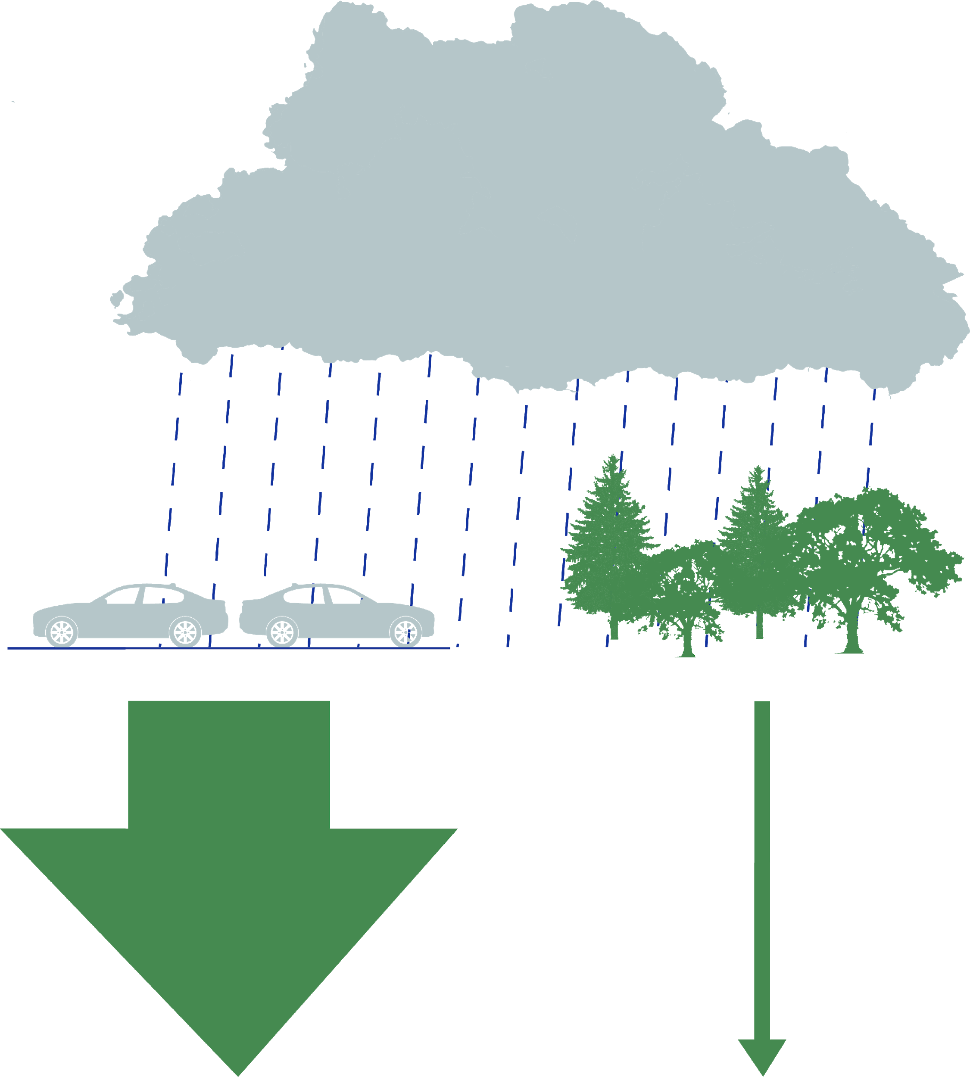
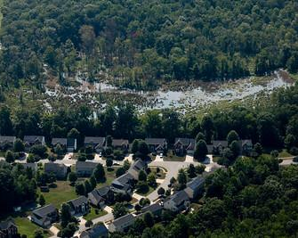
Infrastructure Maintenance and Financing
Trees reduce runoff that can flood communities, stress storm drainage systems, discharge pollutants, and erode local waterways. See module 6 for more information on trees and stormwater resilience.
One inch of rain
Trees save $$$
Trees planted along streams and rivers reduce nitrogen at a cost of $3.10/lb compared to $8.56/lb for wastewater treatment plants.
one acre of forest or wetland
one acre of parking lot
27,000
gallons
of runoff
750
gallons
of runoff
Case study: Prince George’s County, MD
Prince George’s County’s existing trees reduce runoff by 4.3 billion gallons per year, saving $12.8 billion annually on stormwater treatment costs.
Climate Connection
Warmer air holds more moisture, leading to more intense and frequent storms. Increased rainfall can overwhelm local waterways and stormwater systems, amplifying flooding and erosion risks.
Capitalizing on the Benefits of Trees
Benefits to Your Community
Notes:
References:
http://extension.psu.edu/plants/green-industry/landSCaping/culture/the-role-of-trees-and-forests-in-healthy-watersheds
https://lowimpactdevelopment.org/wp-content/uploads/2018/05/Ecosystem-Services.pdf
The Economic Benefits of Protecting Healthy Watersheds, EPA, https://www.epa.gov/sites/production/files/2015-10/documents/economic_benefits_factsheet3.pdf
Photo by W. Parson/Chesapeake Bay Program

Slide 16
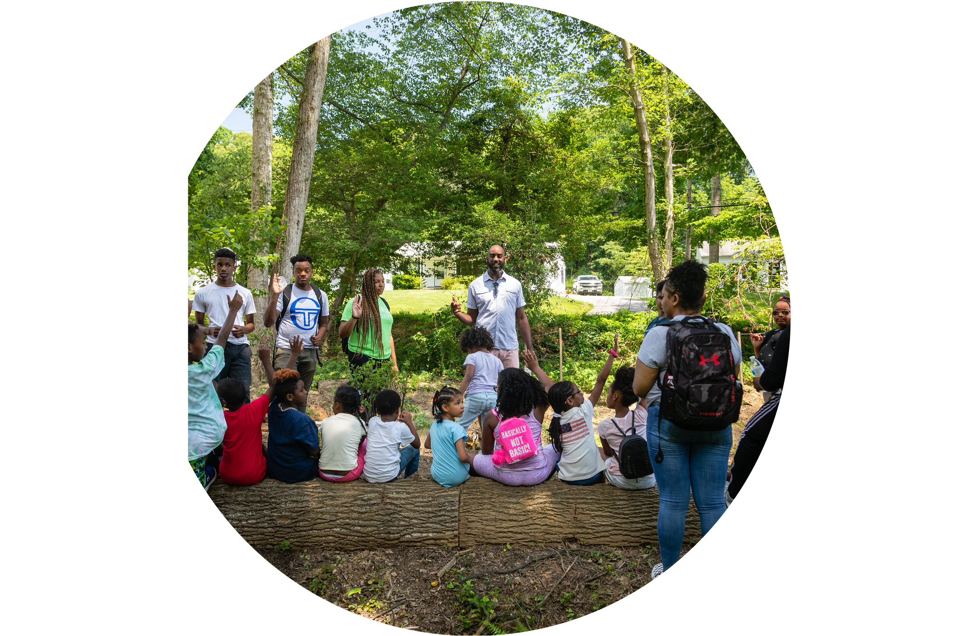
Education
Trees and nature can improve academic outcomes in several ways:
Reading, writing, math, science and social studies improvements.
Enhanced creativity, critical thinking, and problem solving.
Increase in focus and attention and decrease in ADHD symptoms.
Better engagement and enthusiasm for learning.
More impulse control and less disruptive behavior.
Learn more at: https://chesapeaketrees.net/category/schools/
Capitalizing on the Benefits of Trees
Benefits to Your Community
Notes:
References:
Trees and Schools: Growing Connection, accessible at https://chesapeaketrees.net/category/schools/
Photo by W. Parson/Chesapeake Bay Program

Slide 17
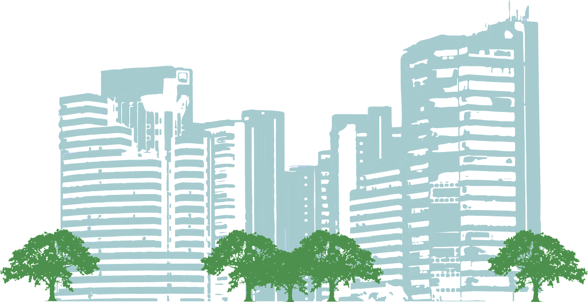
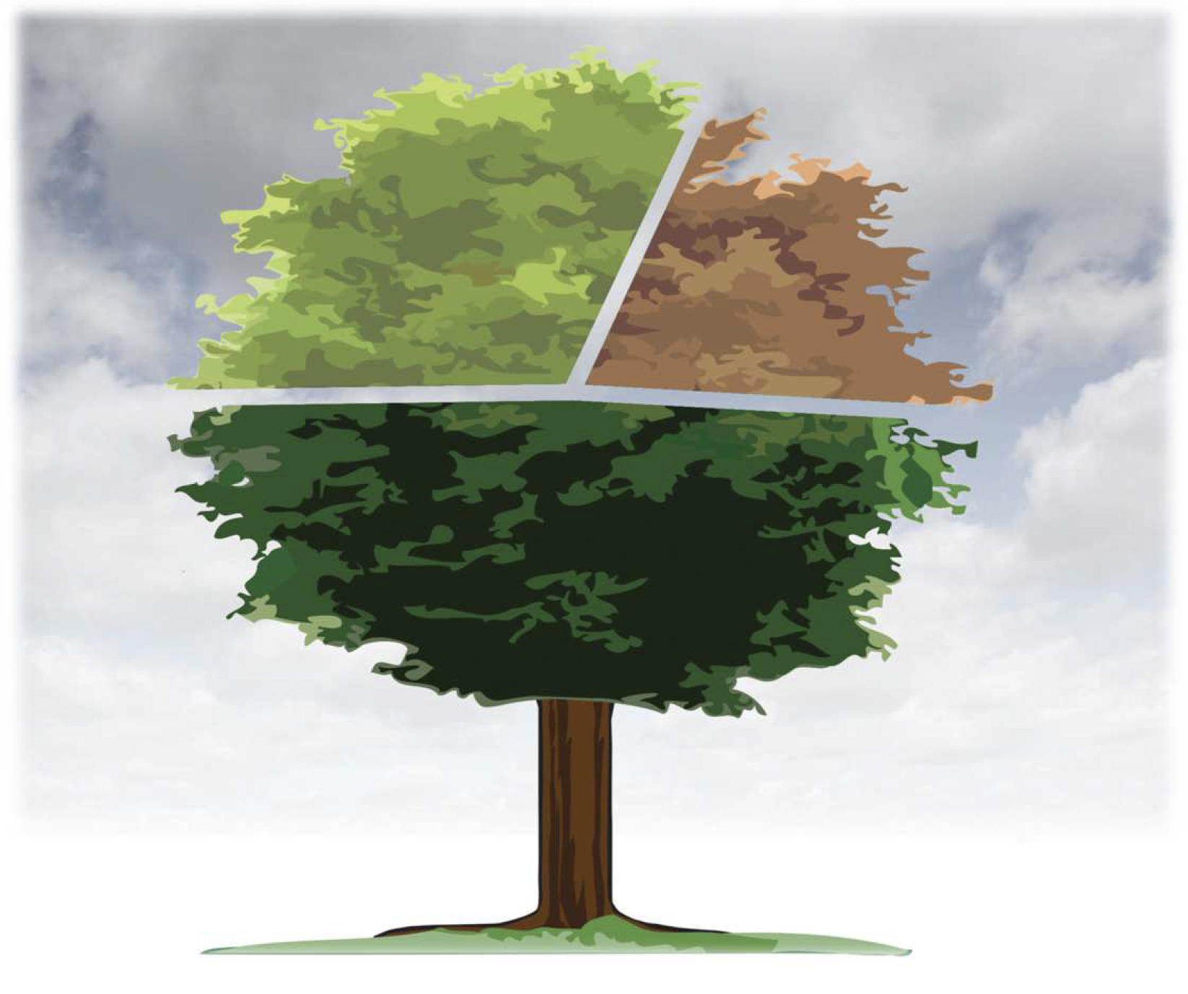
Wider Benefits
Trees remove carbon dioxide from the atmosphere during photosynthesis and store the carbon as part of the tree. This reduces the amount of heat-trapping gases in the atmosphere and can help meet emission reduction goals set by states and cities.
Carbon dioxide reduction
Stormwater runoff reduction
Case study: Blades, DE
iTree calculates that Blades’ community trees provide $54,232 in benefits each year. The graphic to the left shows the breakdown of where those benefits come from.
$15,710
$14,213
$24,309
Air quality improvements
A 2013 study found that the value of carbon sequestered by trees in cities alone is $2 billion annually, with the total value of sequestered carbon in city trees valued at $50+ billion in 2005.
Use i-Tree Landscape to quantify carbon capture and storage potential of the trees in your community, along with other benefits.
Capitalizing on the Benefits of Trees
Benefits to Your Community
For more about the economic benefits of a healthy watershed, see Module 3.
Notes:
References:
Carbon storage and sequestration by trees in urban and community areas of the United States, D. Nowak et al. https://www.fs.usda.gov/treesearch/pubs/46254

Slide 18
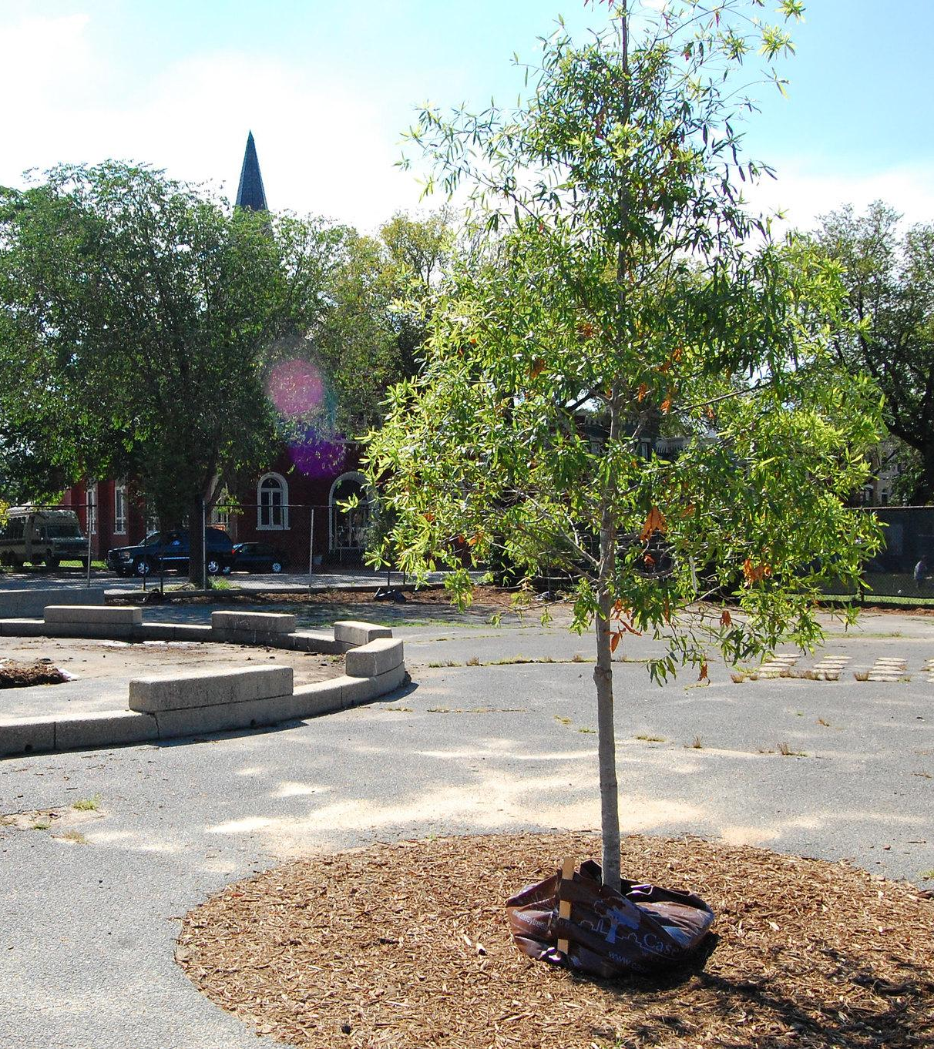
Enhancing Community Trees
Learn about how you can improve tree cover across your community to optimize benefits.
Notes:
Photo by A. Pimental/Chesapeake Bay Program

Slide 19
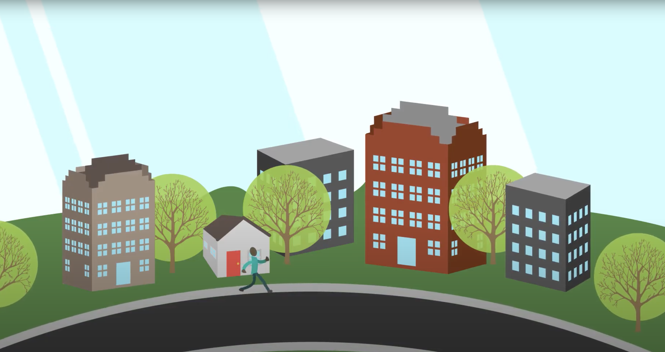
Tree Canopy
Tree canopy is the area of the leaves of a tree or group of trees. Chesapeake watershed communities now have access to highly detailed data, tools, and maps of tree canopy to determine how much they have and help set goals for the future.
Watch this video from the Forest Service to learn more.
Achieving a tree canopy goal
=
+
+
Growth (protection & maintenance)
-
Losses (mortality, removal, etc.)
Existing canopy
Planting
To achieve a tree canopy goal, taking care of your existing trees is just as important as planting new trees. To learn more, visit https://chesapeaketrees.net/understand-your-canopy/.
Capitalizing on the Benefits of Trees
Enhancing Community Trees

Slide 20
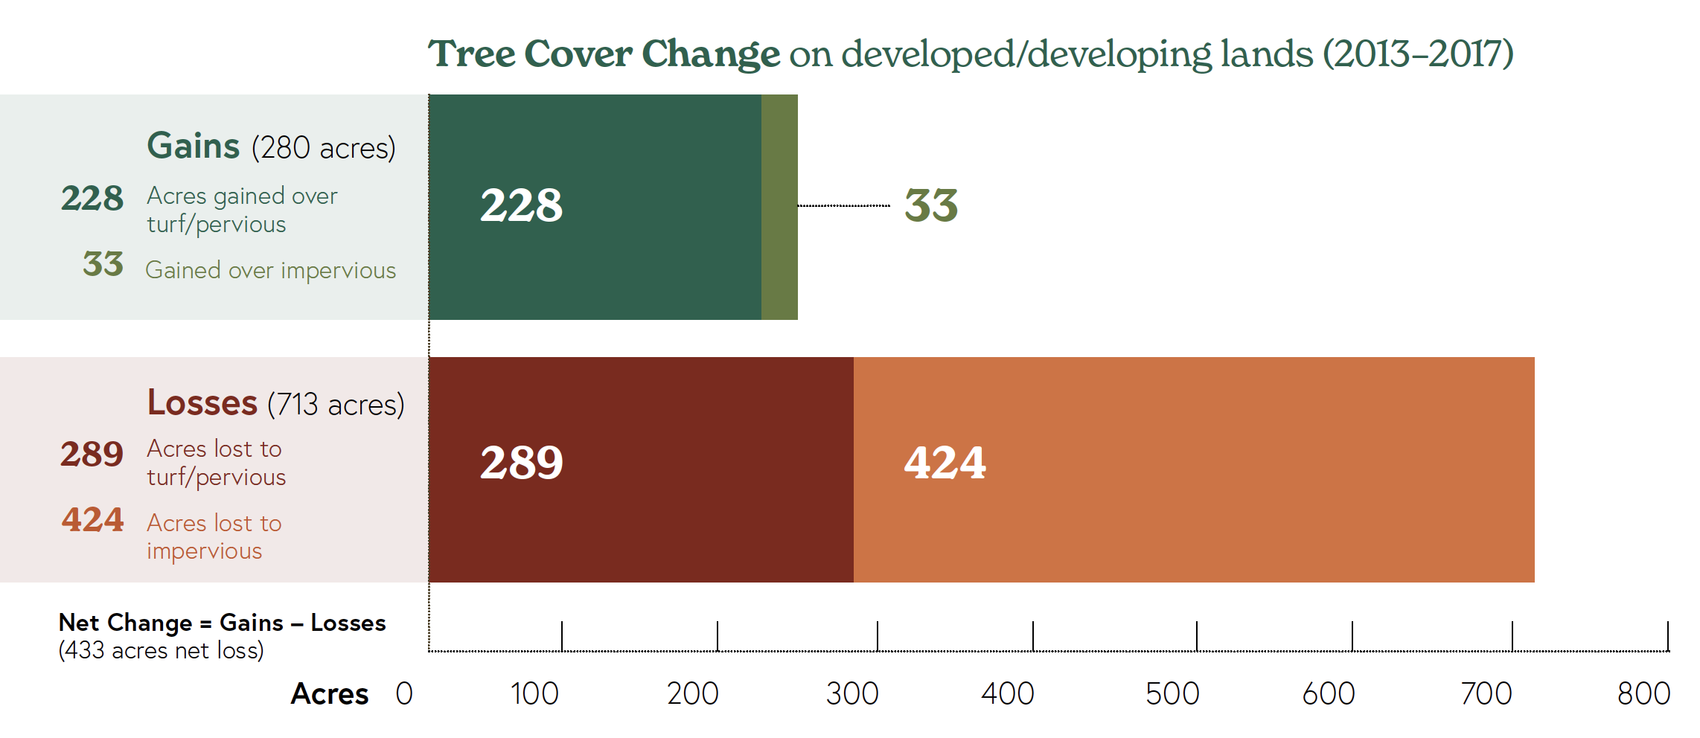
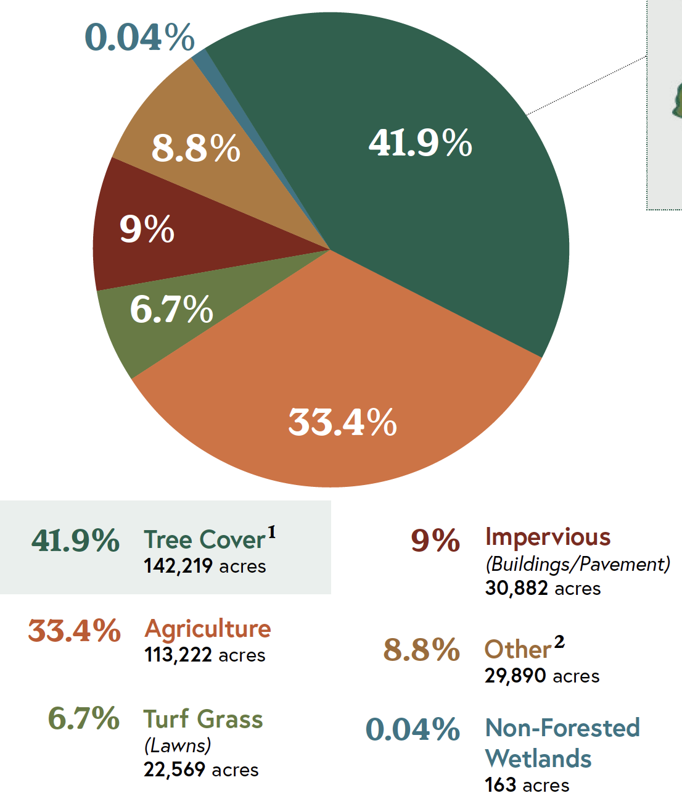
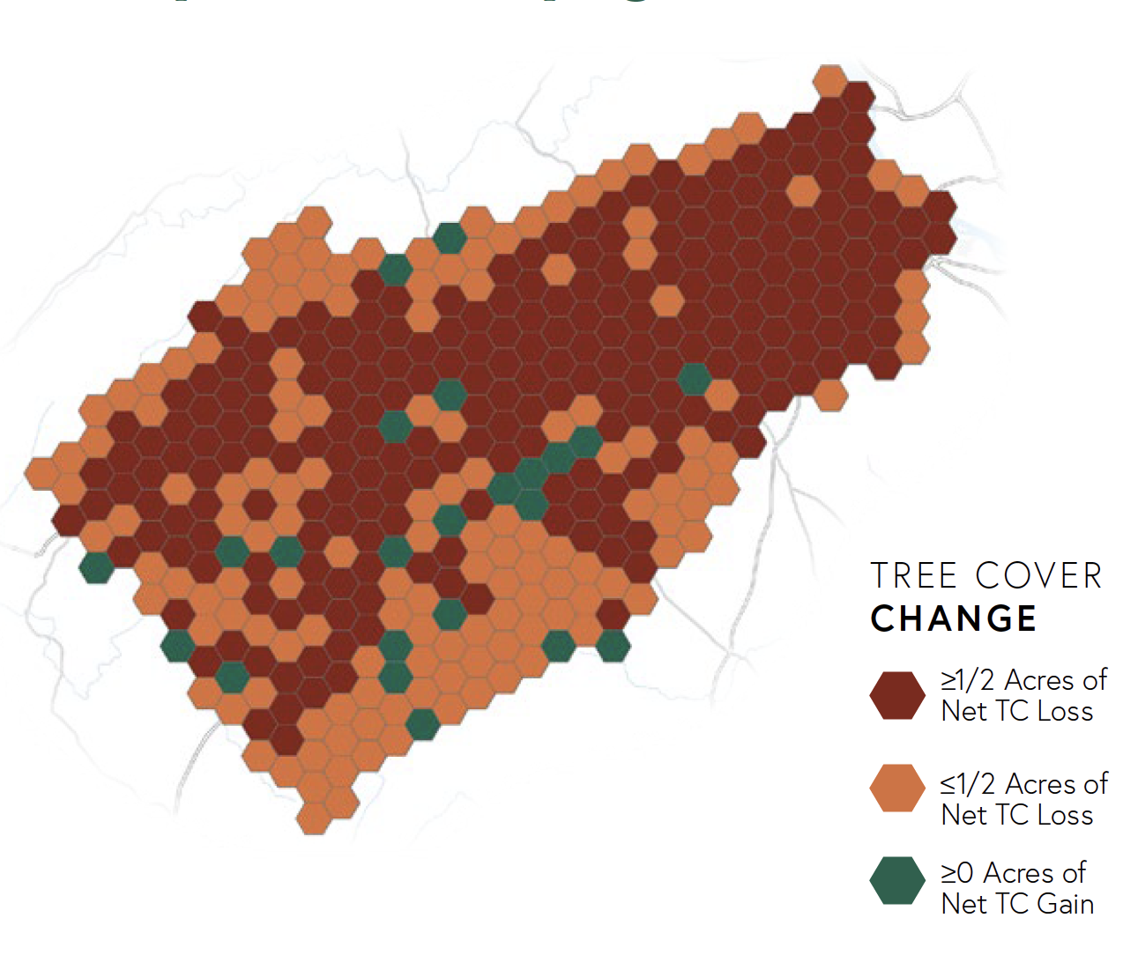

Tree Cover Data
You can take inventory of your community’s trees and use high-resolution tree cover data to craft a tree canopy goal. The new tree canopy data available at the Chesapeake Tree Canopy Network can assist with this. For each community, you can see what’s currently on the land and investigate changes over time.
What’s in your report?
A chart of land cover in your county.
A graph summarizing gains and losses of tree cover.
A map showing what areas have increased or decreased in tree cover.
A summary of the benefits your tree cover offers your community.
Total Air Pollution Removal Value
Gallons of Reduced Stormwater Runoff Value
Carbon Sequestered Value
Capitalizing on the Benefits of Trees
Enhancing Community Trees
Notes:
Photos by W. Parson/Chesapeake Bay Program

Slide 21
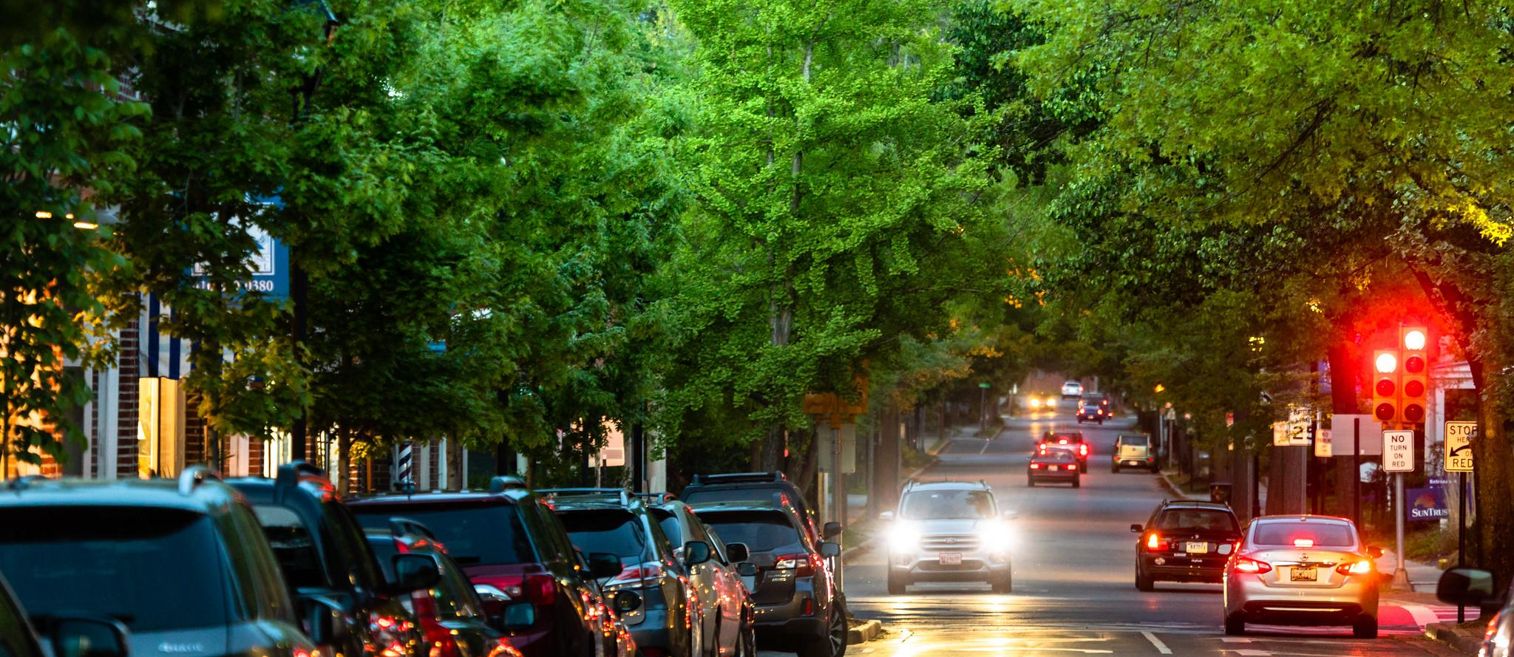
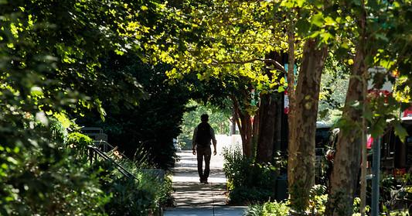
Tree Canopy
Additional tools and information on funding and best practices for setting tree canopy goals can be found in the links at the end of this module.
Case study: Columbia, PA
Columbia is working to meet their 50% tree canopy goal by improving local ordinances and policies as well as developing outreach and education strategies.
Columbia’s Shade Tree Commission has planted and maintained approximately 850 community trees over the past 20 years. The Commission consists of residents and businesses that not only pay membership dues that fund the planting and care of trees, but also serve as a network of ambassadors.
Capitalizing on the Benefits of Trees
Enhancing Community Trees
Notes:
Photos by W. Parson/Chesapeake Bay Program

Slide 22
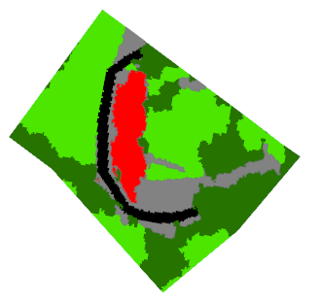
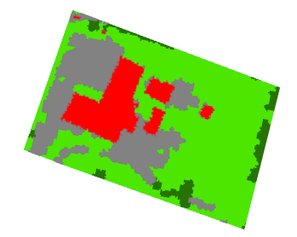
Tree Canopy
Case study: West Virginia Schools
West Virginia conducted a tree canopy analysis of all 87 public schoolyards across the Potomac Basin. Canopy coverage ranges from zero to 78% with the average tree canopy cover of school property at 15%. Tree canopy analysis can also show potential for improvement. The potential in the table below is how much canopy could be added if half of the grass area was planted with trees.
Springfield-Green Spring Elementary: 32% tree canopy with a potential of 52%.
School | Acres | Tree Canopy | Potential
Augusta Elementary School | 5.2 | 13% | 25.0%
Back Creek Valley Elementary School | 5.1 | 4% | 39.9%
Bedington Elementary School | 4.3 | 5% | 33.8%
Berkeley Heights Elementary School | 22.8 | 6% | 34.3%
Berkeley Springs High School | 11.8 | 2% | 30.5%
Blue Ridge Elementary School | 31.4 | 60% | 71.1%
Brandywine Elementary School | 3.6 | 13% | 35.2%
Springfield-Green Spring Elementary School | 14.7 | 32% | 52.0%
Bunker Hill Elementary School | 4.0 | 6% | 42.8%
Burke Street Elementary School | 4.0 | 1% | 3.2%
Bedington Elementary: 5% tree canopy with a potential of 33.8%.
Building
Vegetation
Road
Impervious
Tree Canopy
Capitalizing on the Benefits of Trees
Enhancing Community Trees
Notes:
References:
https://chesapeaketrees.net/2016/06/29/west-virginia-increasing-tree-canopy-schools/
https://www.cacaponinstitute.org/discover/urban-tree-canopy/

Slide 23
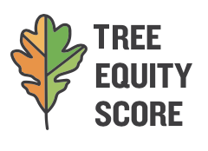

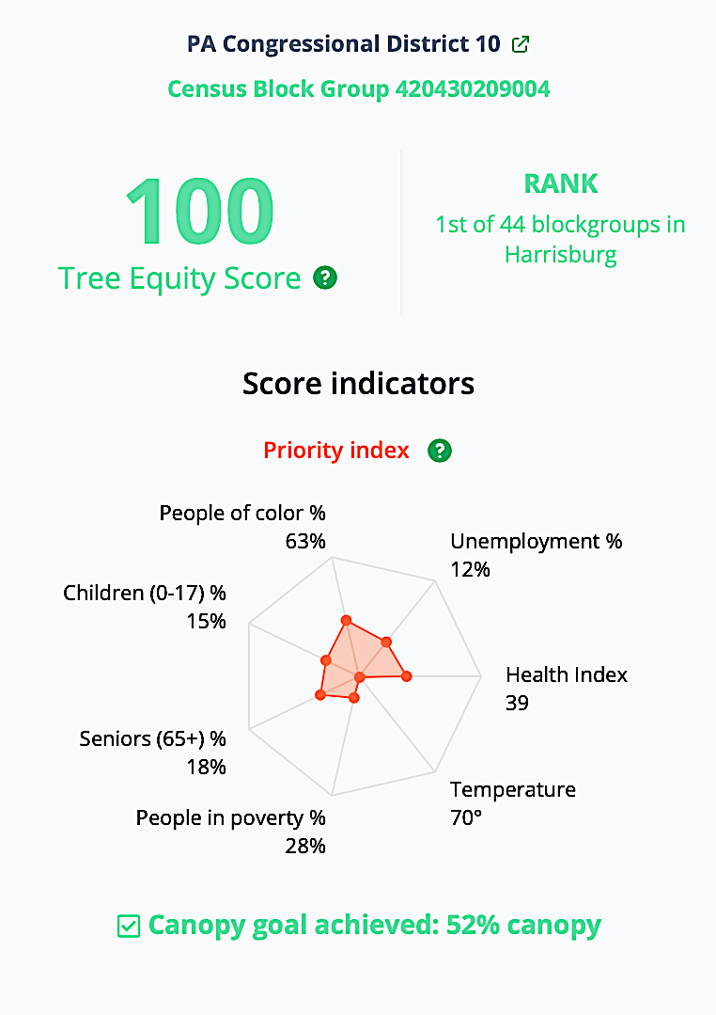
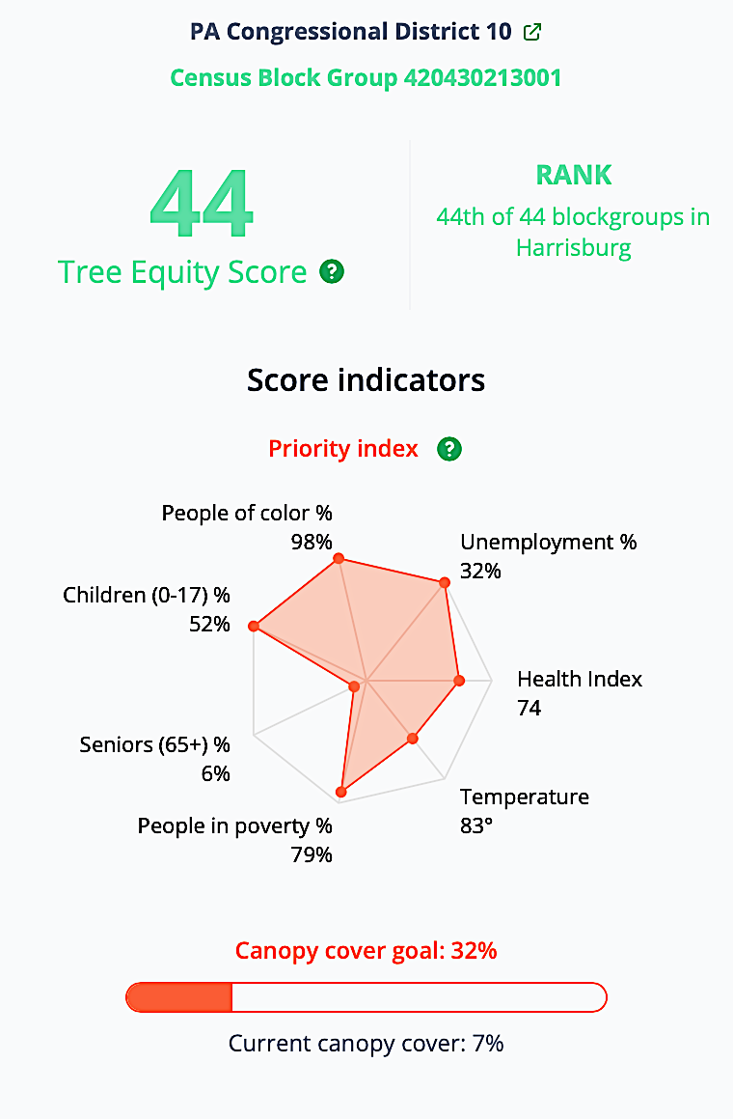
Tree Equity Score
Visit treeequityscore.org to explore your tree equity
Tree canopy is not always shared equitably. A Tree Equity Score combines 8 priority indices for neighborhoods within census-defined urban areas to help prioritize tree protection and planting efforts.
Case study: Harrisburg, PA
Compare the highest and lowest tree equity scores in Harrisburg, PA to the right.
One census block has met the 52% tree canopy goal and has lower priority scores for every indicator, earning a Tree Equity Score of 100.
The other block has a current canopy cover of only 7% and has high percentages of children, people of color, unemployment, and poverty. These priority indices combined into a Tree Equity Score of 44.
Capitalizing on the Benefits of Trees
Enhancing Community Trees

Slide 24
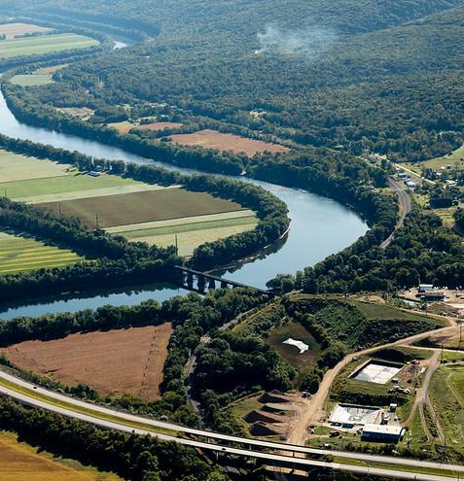
Forest Buffers
Riparian forest buffers are stands of trees, shrubs, and grasses strategically planted or conserved directly adjacent to waterways. Planting forest buffers helps clean and cool streams, which can make the water in our streams more swimmable and drinkable for us and wildlife.
Capitalizing on the Benefits of Trees
Enhancing Community Trees
Notes:
References:
Riparian Forest Buffers in the Chesapeake Bay Watershed, Chesapeake Bay Program: https://nepis.epa.gov/Exe/ZyPURL.cgi?Dockey=P100VW0Y.txt
Photo by W. Parson/Chesapeake Bay Program

Slide 25
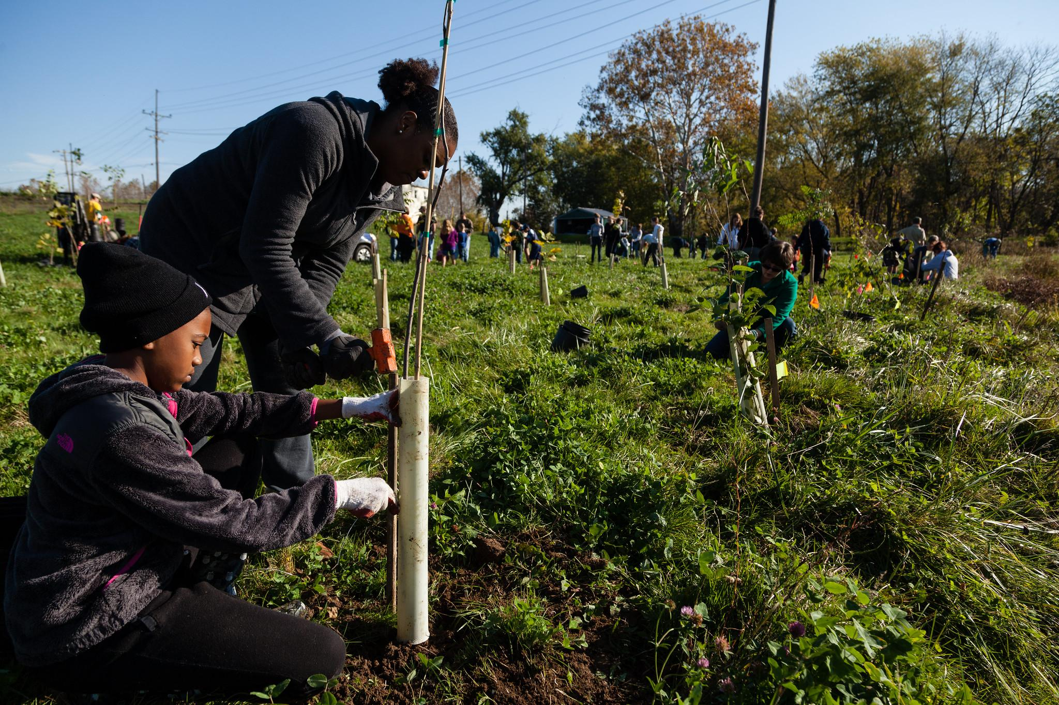
Forest Buffers
Planting trees has helped some counties meet their Municipal Separate Storm Sewer System (MS4) requirements. Learn more about MS4s in Module 6.
Case study: Frederick County, MD
Frederick County’s Creek ReLeaf Program has planted 200+ acres of forest, mostly as riparian buffers. The program was started in 2017 to help meet MS4 requirements.
The program, funded through multiple sources including MD’s Chesapeake & Atlantic Coastal Bays Trust Fund, offers property owners free native plants and the first five years of forest maintenance as well as a permanent reforestation easement at 75% of fair market value.
The program has also reforested public lands.
Capitalizing on the Benefits of Trees
Enhancing Community Trees
Notes:
References:
Reforestation for MS4 Credit in Frederick County, MD: https://www.mwcog.org/file.aspx?&A=xzNG1Ub%2FqJ7QZJ%2FEki8eZWHGdVHHr5xX8IFR0dfp23k%3D
Photo by W. Parson/Chesapeake Bay Program

Slide 26
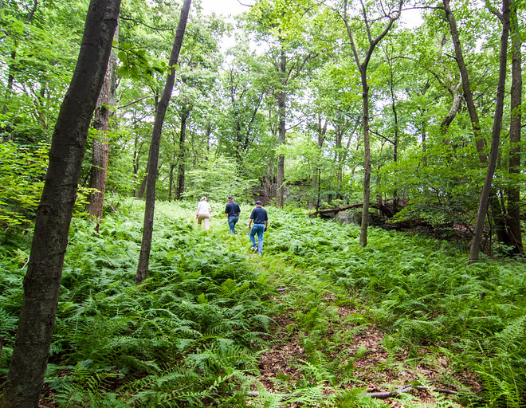
Conserving Forests
Forest conservation is the retention or protection of existing forests and the benefits they provide to communities. Retaining your tree canopy offsets future expenses.
Over the course of 10-15 years, a forest retention analysis demonstrated that the cost of meeting federal pollution limits could be offset by modest forest retention effort.
In the Yellow Breeches Creek watershed (PA), over 15 years (2010-2025):
a 10% reduction in the rate of forest loss could save $12.28 million.
In a portion of the Rappahannock River watershed (VA), over 10 years (2015-2025):
a 10% reduction in the rate of forest loss could save $125 million.
In MD, the Forest Conservation Act requires surveys of current trees in large development sites and plans to retain & protect or plant & maintain trees. Learn more here.
Capitalizing on the Benefits of Trees
Enhancing Community Trees
Notes:
References:
Healthy Watersheds Forest Retention Project Phases 1 & 2 Final Report. https://www.chesapeakebay.net/documents/Healthy_Watersheds_TMDL_Forest_Retention_Final_Report.pdf
Photo by Leslie Robertson for the National Association of State Foresters

Slide 27
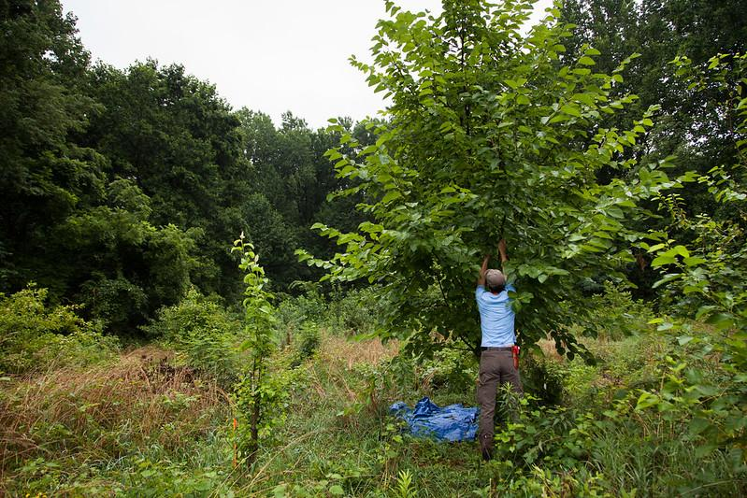
Incentives
Incentives often garner more public support than punitive measures, making them an attractive option. Learn more about conservation tools in Module 5.
Case study: Albemarle County, VA
In the 1970s, Albemarle County’s Department of Planning and Community Development designated Rural Areas with growth restrictions to encourage conservation.
Since then, the County has implemented a use-value tax assessment program to reduce the property taxes for landowners in agriculture, forestry, and other open space uses. In addition, the Acquisition of Conservation Easements program allows landowners to sell conservation easements to public agencies, with low-income landowners qualifying for higher payments.
Capitalizing on the Benefits of Trees
Enhancing Community Trees
Notes:
References:
Chesapeake Bay Trust: Conservation Land-Use Policy Toolkit, page 61: https://www.chesapeakebay.net/channel_files/25323/chesapeake_land_use_policy_report_final_5-31-2017.pdf
Photo by S. Ballard/Chesapeake Bay Program

Slide 28



What You Can Do
Establish a tree canopy goal for your community. Engaging residents in creating and implementing a plan inspires them to be better stewards of their community.
Explore and diversify funding opportunities, like state and federal grants, stormwater management fees, and parks and recreation department funds, to ensure continuous funding to meet your community’s tree goals.
Update local codes, ordinances, plans, and standards to encourage best practices for tree planting, maintenance, and conservation.
Get residents involved! Use internship programs to supplement staff on planting projects, support active tree commissions or boards, and explore opportunities to involve schools in stewardship activities.
Notes:
Urban Tree Canopy Goal Setting Guide: https://www.chesapeakebay.net/documents/UTC_Guide_Final.pdf

Slide 29
To Learn More
Chesapeake Tree Canopy Network
  Connect with resources, stories, and best practices to understand, expand, and maintain your canopy
Chesapeake Riparian Forest Buffer Network
  Learn about building a forest buffer program, including funding resources
Vibrant Cities Lab’s Urban Forestry Toolkit
  Explore step-by-step instructions, tools, and methods for enhancing urban tree canopy cover
Financing Urban Tree Canopy Programs Guide and Online Course
  Find practical strategies for funding municipal urban tree canopy programs and enroll in a course based on the guide
Center for Watershed Protection’s Making Your Community Forest-Friendly Worksheet
  Use this checklist to review your local development regulations and see where you can make improvements
Trees and Schools: Growing the Connection
  Explore resources that connect students, schools, and trees

Slide 30
Glossary
Stormwater Runoff
  Precipitation that does not evaporate or soak into the ground but instead flows over the land and into the nearest waterway
Nutrients
  Refers to nitrogen and phosphorous, two nutrients that severely degrade local waterways and the Bay when discharged in excess
Sediment
  Creates cloudy water which negatively impacts important species like underwater grasses and oysters
Bacteria
  Microorganisms that can make humans and wildlife sick. Examples include E. coli, Salmonella, and Vibrio
Microplastics
  The tiny (<5 mm) fragments, fibers, and microbeads that come from larger plastic litter breaking apart and persist in the environment for an extremely long time
Agricultural Biproducts
  Pesticides, fertilizers, hormones, and more that can harm human and wildlife health. An example is antibiotics used to treat animals, which could facilitate antimicrobial resistance
Urban Toxic Contaminants
  Metals, synthetic compounds, and more that can harm human and wildlife health. An example is mercury, which is toxic to nervous, digestive, and immune systems
Urban Heat Island
  Urbanized areas that experience higher temperatures than outlying areas
Tree Canopy
  The layer of leaves, branches, and stems that provide coverage of the ground when viewed from above
Forest Buffer
  The trees and other plants that border streams and rivers
MS4: Municipal Separate Storm Sewer System
  A collection of structures designed to gather stormwater and discharge it into local streams and rivers

Slide 31
Images and Graphics
Urban Heat Islands
  Graphics by Green Fin Studio
Infrastructure Maintenance and Financing
  Photo by W. Parson/Chesapeake Bay Program
  Graphics by Green Fin Studio
Education
  Photo by W. Parson/Chesapeake Bay Program
Wider Benefits
Graphics by Green Fin Studio
Enhancing Community Trees
  Photo by A. Pimental/Chesapeake Bay Program
Tree Canopy
Photo by W. Parson/Chesapeake Bay Program
Video by Forest Service
Forest Buffers
Photo by W. Parson/Chesapeake Bay Program
Conserving Forests
Photo by Leslie Robertson for the National Association of State Foresters
Incentives
Photo by S. Ballard/Chesapeake Bay Program
Title Page
  Photo by O. Giron /Chesapeake Bay Program
Table of Contents
  Photo by W. Parson/Chesapeake Bay Program
Laying Foundations
  Photo by Leslie Robertson for the National Association of State Foresters
What You’ll Learn
Photos by W. Parson and S. Droter/Chesapeake Bay Program
Benefits to Your Community
  Photo by M. Rath/Chesapeake Bay Program
Economic Development
Photo by W. Parson/Chesapeake Bay Program and Leslie Robertson for the National Association of State Foresters
Graphics by Green Fin Studio
Recreation on Forested Land
Graphics by Green Fin Studio
Clean Air and Water
Graphics by Green Fin Studio
Benefits for Agriculture
Photos by W. Parson/Chesapeake Bay Program

